Slide 1

Computer Networking CCNA 200-301

Slide 2
Course Outline
Module 1 Network Fundamentals
Explain Role and Function of Network Components : Routers, Switches, Firewall, IPs, WLC, AP, Endpoints, Servers
OSI Reference Model and TCP/ IP Model
IPv4 Addressing and Subnetting
IPv6 Addressing and IPv6 address Types
Module 2 Basic Configuration of Router and Lan Switching
Modes of Router
Basic Security of Router (Passwords) and Configuration of IP on Router
Point to Point connectivity of Routers
Configure and Verify Layer2 Discovery Protocols (CDP and LLDP)
Basic Operation of Switch (Collision Domain and Broadcast Domain)
Spanning-tree Protocol (PVST, RSTP), Port states and Port fast
Configure and Verify VLANS and Inter-switch Connectivity (Trunk ports, 802.Iq)
Ether-channel
Cisco Wireless Architecture and AP modes
Configuration of Wireless Lan Controller and AP Using GUI (WPA, WPA2, PSK)

Slide 3
Course Outline
Module 3 IP Routing
Static Routing with IPv4 and IPv6, floating static route and Default route
Configure and Verify Single area OSPF
DR and BDR election. Point to point, Concept of Router-ID
Module 4 IP Services
NAT
Configure and Verify NTP
Describe DNS, SNMP, Syslog, QOS, Function of FTP and TFPF in network
Configuration of DHCP, telnet and SSH
Describe the function of First hop redundancy protocol (HSRP, VRRP, GLBP)

Slide 4
Course Outline
Module 5 Security Fundamentals
Configure and Verify Access control List
Describe VPN Technologies (Site-to-site VPN and Remote access VPN)
Describe Authentication, Authorization and Accounting (AAA)
Configure Port Security, DHCP Snooping and Dynamic ARP Inspection
Module 6 Automation and Programmability
Explain how automation impacts network management
Compare traditional network with controller-based networking
Compare traditional campus device management with Cisco DNA Center enabled device Management.

Slide 5
Module 1 Network Fundamentals
Explain Role and Function of Network Components : Routers, Switches, Firewall, IPs, WLC, AP, Endpoints, Servers
OSI Reference Model and TCP/ IP Model
IPv4 Addressing and Subnetting
IPv6 Addressing and IPv6 address Types

Slide 6
CCNA
200-301
Basic Level
Company or Vendor
CCNA Stands for “Cisco Certified Network Associate “
CCNA (R & S ) 200-125 Old Batch
CCNA (200-301) New Batch
We will Study CCNA(200-301)

Slide 7
Network
What is Network
When two or more computer connect together and start communication with each other
A Computer Network is defined as a set of two or more computers that are linked together, either via wired cables or wireless networks i.e. WIFI with the purpose of communicating, exchanging, sharing or distributing data, files and resources.

Slide 8
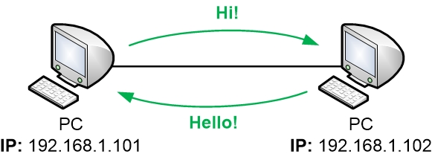
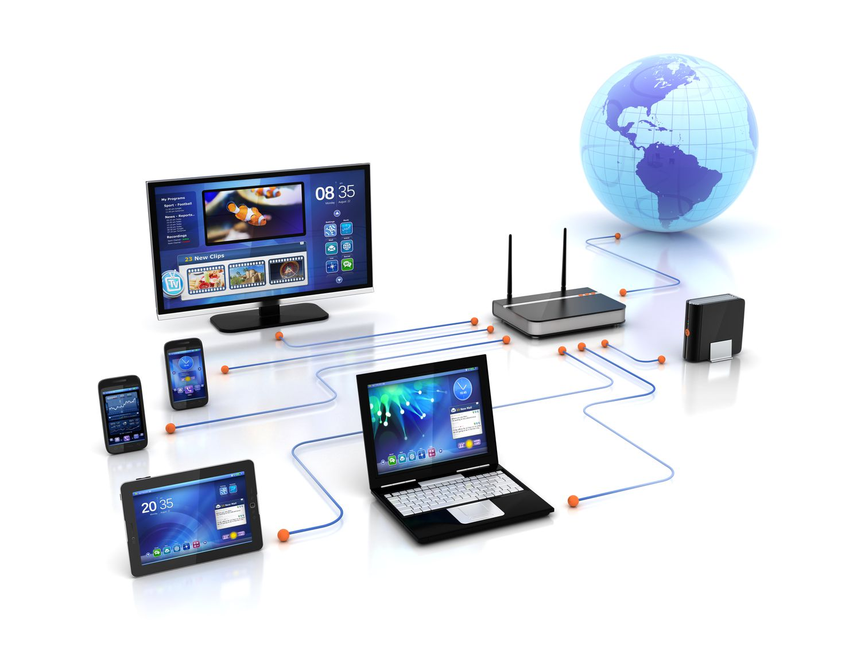
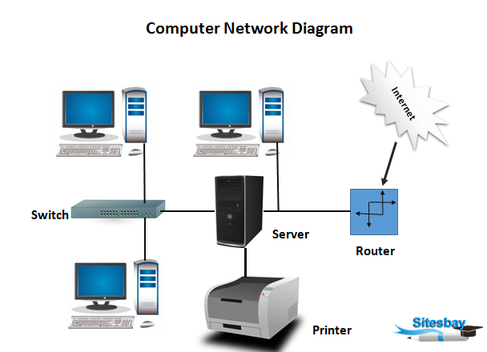

Slide 9
Types of Computer Network
LAN (Local Area Network)
WLAN (Wireless local area network)
CAN (Campus Area Network)
MAN (Metropolitan Area Network)
PAN (Personal Area Network)
SAN (Storage Area Network)
VPN (Virtual Private Network)
WAN (Wide Area Network)

Slide 10
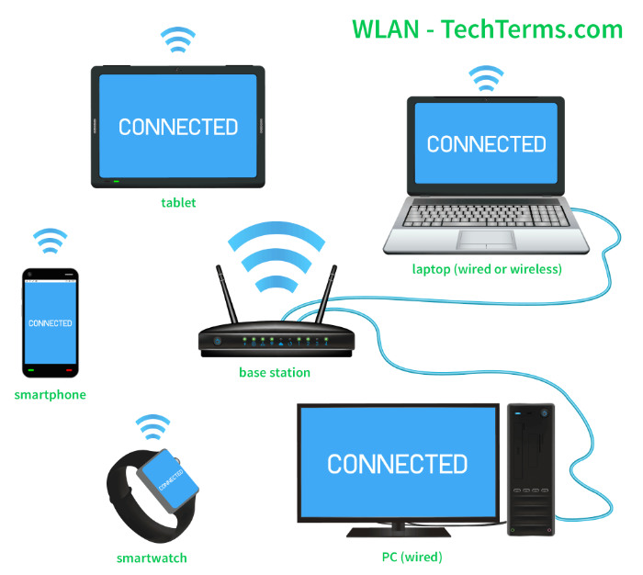
LAN (Local Area Network)
LAN or Local Area Network is a group of devices connecting the computers and other devices such as switches, servers, printers, etc., over a short distance such as office, home. The commonly used LAN is Ethernet LAN. This network is used as it allows the user to transfer or share data, files, and resources

Slide 11
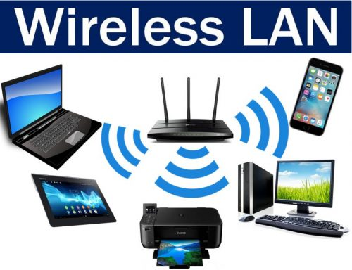
WLAN (Wireless local area network)
WLAN or Wireless local area network is similar to LAN with the difference that it uses wireless communication between devices instead of wired connections. WLAN typically involves a Wi-Fi router or wireless access point for devices, unlike smartphones, laptops, desktops, etc.

Slide 12
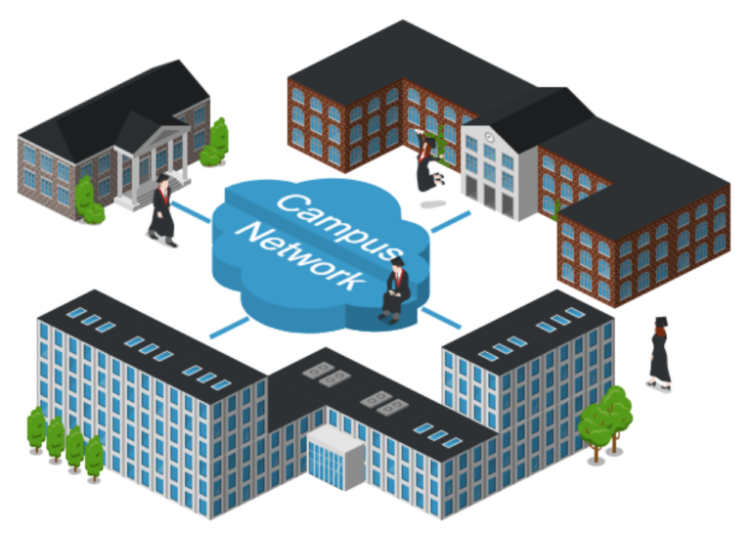
CAN (Campus Area Network)
A Campus Area Network (CAN) is a network that connects computers and devices within a specific geographic area, such as a university campus, corporate campus, or industrial complex. It allows for communication and resource-sharing among these devices, facilitating efficient data exchange in a localized environment.

Slide 13
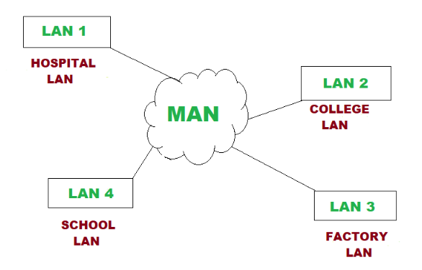
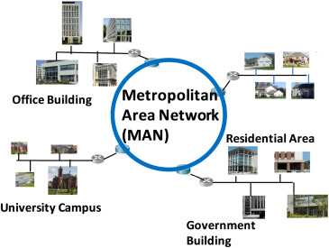
MAN (Metropolitan Area Network)
MAN or Metropolitan Area Network is typically a more extensive network when compared to LANs but is smaller than WANs. This network ranges between several buildings in the same city. Man networks are connected via fiber optic cable (usually high-speed connection). Cities and government bodies usually manage MANs.

Slide 14
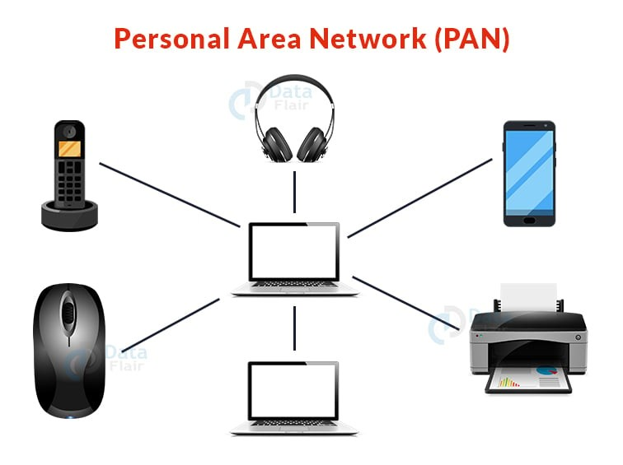
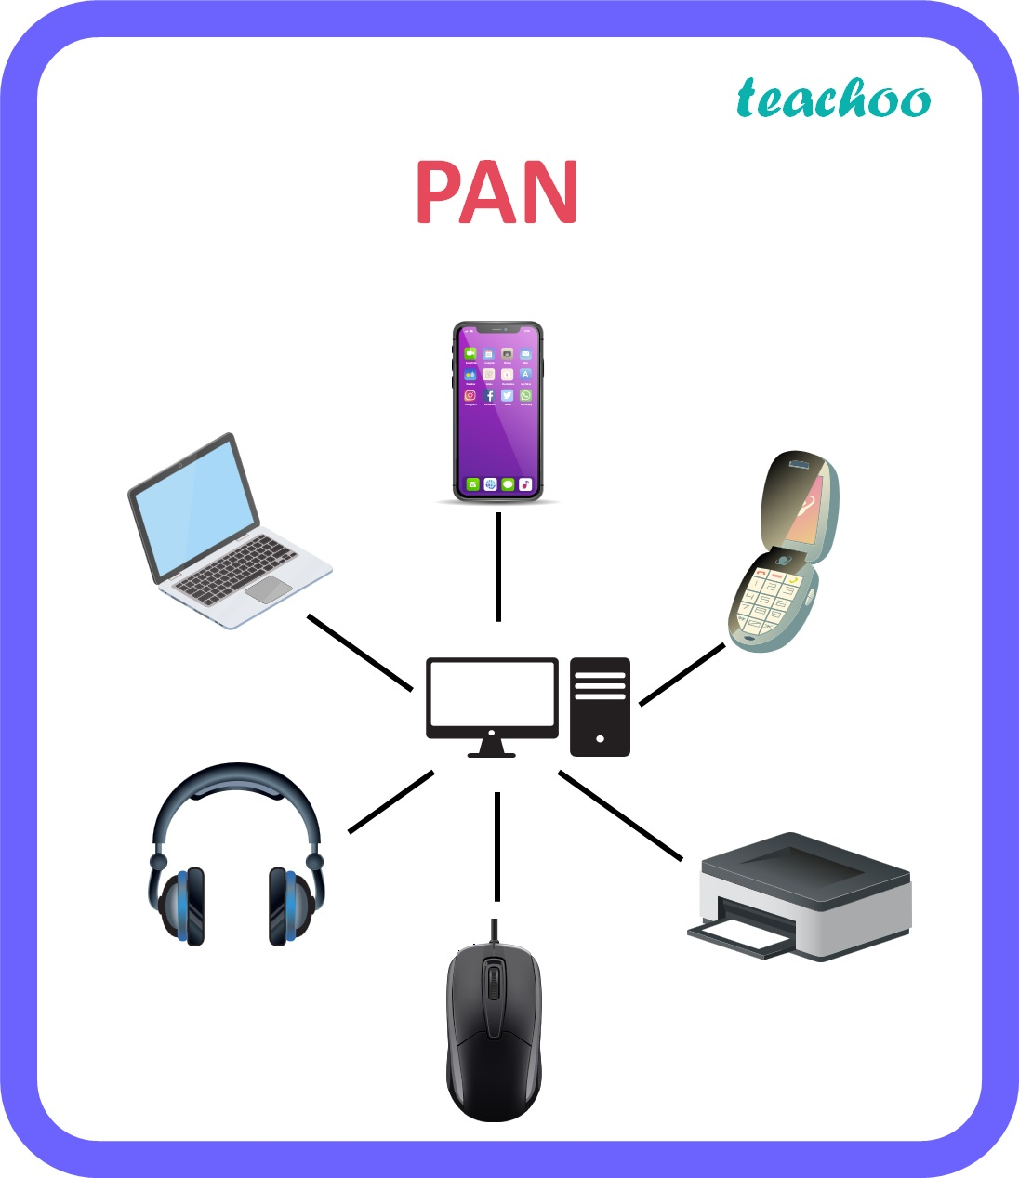
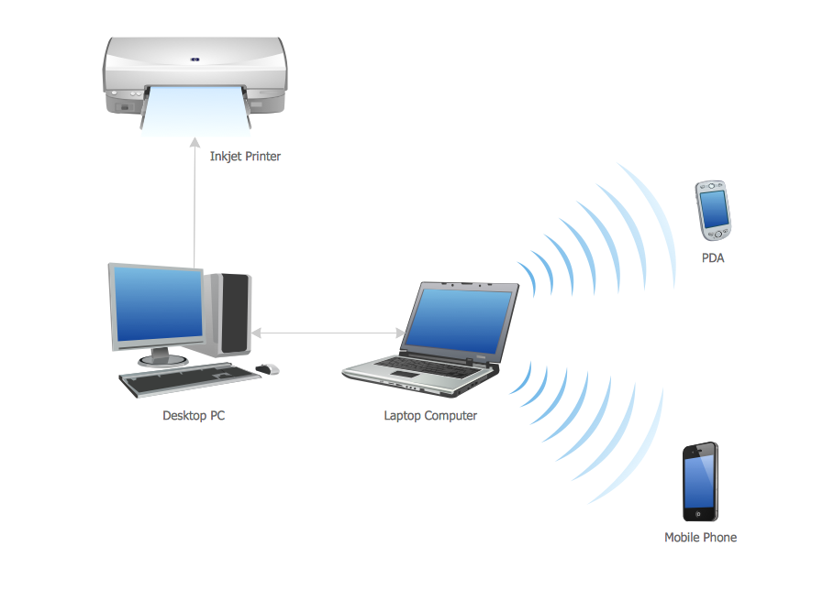
PAN (Personal Area Network)
A Personal Area Network (PAN) is a small network that connects devices, like smartphones, laptops, and tablets, within an individual's personal space, typically within a range of a few meters. It allows these devices to communicate and share information wired or wirelessly for personal use.

Slide 15
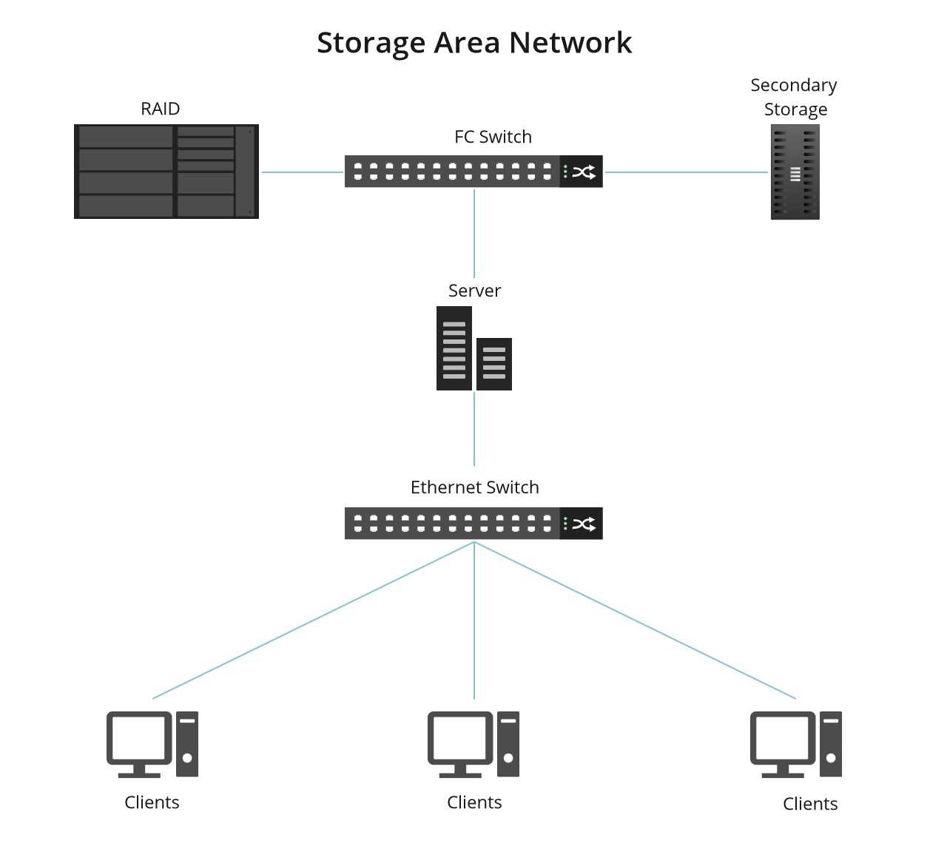
SAN (Storage Area Network)
A Storage Area Network (SAN) is a network of storage devices that can be accessed by multiple servers or computers, providing a shared pool of storage space. Each computer on the network can access storage on the SAN as though they were local disks connected directly to the computer.

Slide 16
Don’t get confused
A Storage Area Network (SAN) is like a high-speed, special network at a big company that helps store and organize computer data efficiently.
iCloud and Google Cloud Storage are like online spaces where you can store your pictures, documents, and stuff. They use the internet and fancy systems to keep your things safe and accessible from different devices.
So, while they all deal with storing data, SAN is a specific type of network within a company, and iCloud or Google Cloud Storage are more like online spaces you can use for your personal or business data. They work in different ways, but the goal is to help you keep your digital stuff safe and accessible.

Slide 17
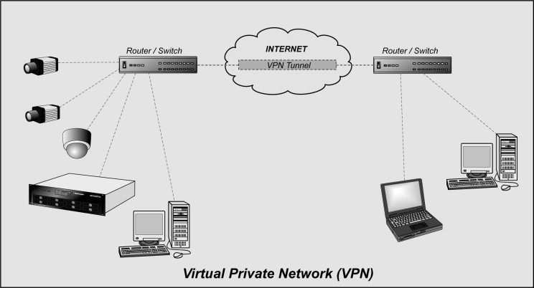
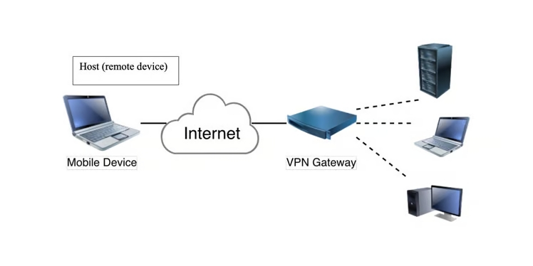
VPN (Virtual Private Network)
Will be Explained in detail in later topics
A Virtual Private Network (VPN) is like a secure tunnel on the internet. It helps keep your online activities private by encrypting (protecting) your connection, making it safe for things like browsing or working from anywhere.
A secure tool that encrypts point-to-point Internet connection and hides the user's IP address and virtual location.

Slide 18
WAN (Wide Area Network)
WAN or Wide Area Network is the most significant network type connecting computers over a wide geographical area, such as a country, continent. WAN includes several LANs, MANs, and CANs. An example of WAN is the Internet, which connects billions of computers globally.
A Wide Area Network (WAN) is like a big internet connection that links computers and networks across long distances. It helps people in different locations share information and work together, just like they're in the same place.

Slide 19
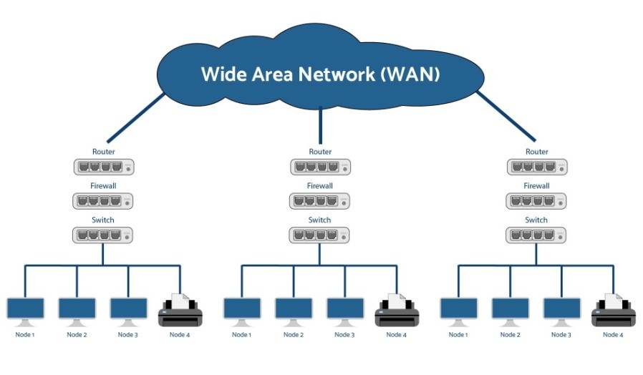
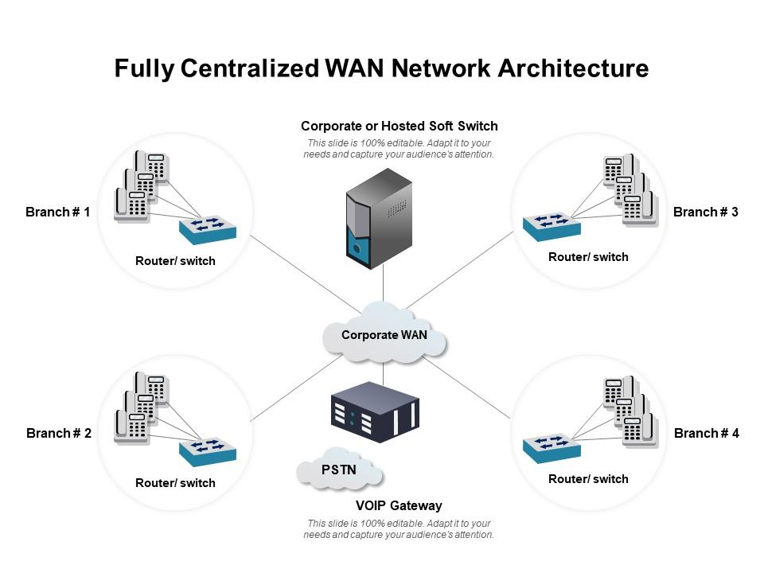
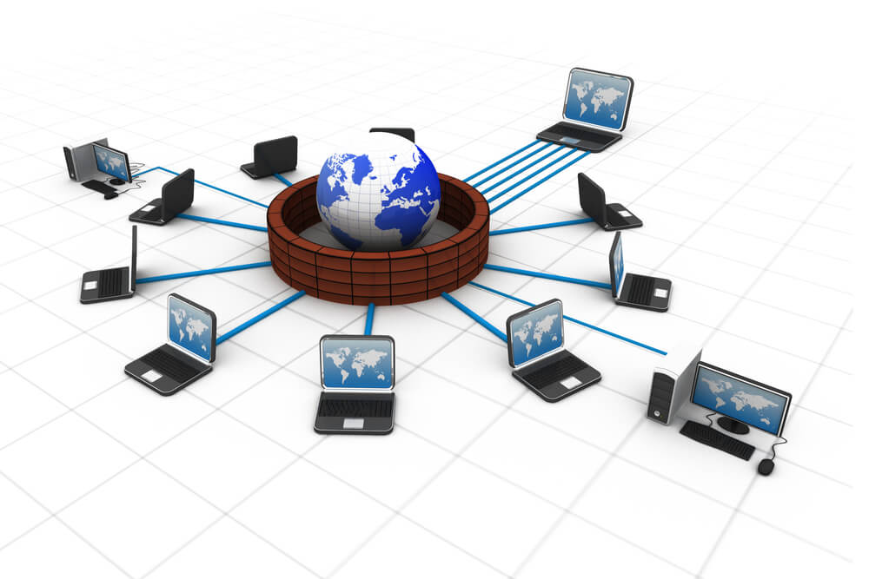
WAN (Wide Area Network)

Slide 20

Networking Basics: Introduction to Key Components

Slide 21
Hub: Sharing Data Across a Local Network
🔸 A hub is a basic networking device
🔸 It connects multiple devices in a local network
🔸 Sends data to all connected devices, not just the intended one
🔸 When one device sends data, the hub broadcasts it to all ports
🔸 All devices receive the data, but only the target device uses it
🔸 Works like a loudspeaker, not a private message

Slide 22
Hub: Sharing Data Across a Local Network
Working:
At the sender’s side:
Device (say PC1) creates a frame (layer 2 data unit).
The frame has a source MAC address (PC1’s MAC) and a destination MAC address (the target PC’s MAC).
At the hub:
The hub does not look at MAC addresses at all.
It is a Layer 1 device (Physical layer).
It only deals with electrical signals / bits.
Broadcasting:
The hub simply regenerates and forwards the signal to all ports (except the one it came from).
It does not check which MAC is inside, or who the real destination is.
At the receiving devices:
All connected devices see the frame.
Each device checks the destination MAC address inside the frame.
Only the device with the matching MAC accepts it; others discard it.

Slide 23
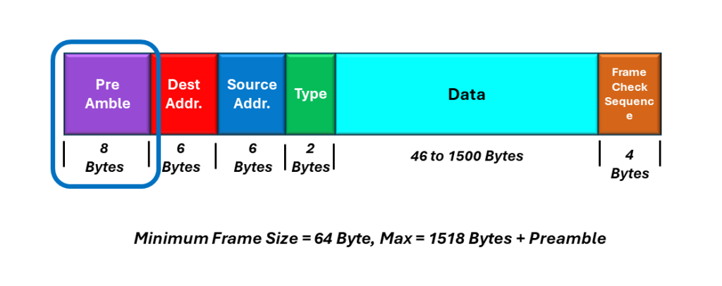
Hub: Sharing Data Across a Local Network
Visual View (Ethernet Frame):

Slide 24
Hub: Sharing Data Across a Local Network
Visual View (Ethernet Frame)
Preamble (7 bytes) + Start Frame Delimiter (1 byte):
Helps devices synchronize.
Tells the receiver: “A new frame is starting.”
Destination MAC Address (6 bytes):
The hardware (MAC) address of the device the frame is meant for.
All devices see it, but only the one with this MAC accepts it.
Source MAC Address (6 bytes):
The MAC address of the sender.
EtherType / Length (2 bytes):
Either tells the type of protocol inside (like IPv4, IPv6, ARP)
Or the length of the data field.
Payload / Data (46–1500 bytes):
The actual data being carried (like an IP packet). “IP packet” means the data unit that carries the sender’s IP and receiver’s IP
If the data is too short, padding is added to meet the minimum size.
Frame Check Sequence – FCS (4 bytes):
Used for error detection (CRC).
The receiver checks this to see if the frame arrived correctly.
Hub: Doesn’t read the frame → just sends bits to all ports.

Slide 25
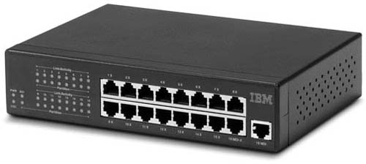
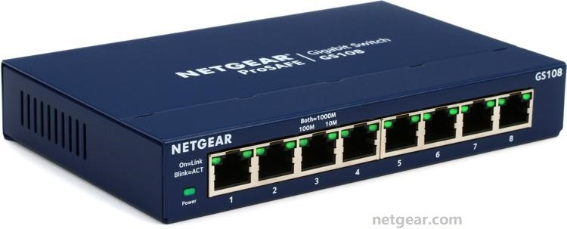
Hub: Sharing Data Across a Local Network

Slide 26
Switch: Connecting Devices on a Local Network
🔸 A switch connects multiple computers in a network
🔸 It creates a local area network (LAN). To connect devices like PCs, printers, etc.
🔸 Sends data only to the correct device using MAC addresses
🧠 How Does a Switch Work?
🔸 Every device has a MAC address
🔸 The switch keeps a table of these addresses
🔸 It sends data only where it’s needed, not to everyone
The frame itself is the same whether it’s sent through a hub or a switch:
Ethernet frame format does not change.
Switch: Reads the frame’s MAC addresses → forwards it smartly.

Slide 27
Switch: Connecting Devices on a Local Network
Manageable Switch:
A switch that can be configured and managed, allowing control over network settings, traffic prioritization, VLANs, and monitoring through tools like a web interface or CLI.
Catalyst 2960, 3560, 3650, 3850, 9200, 9300, 9500, etc.
Nexus 2000, 3000, 5000, 7000, and 9000 series.
Cisco 250, 350, 550 series.
Unmanageable Switch:
A simple, plug-and-play switch with no configuration or management options, ideal for basic network connectivity.
Cisco 100 Series.
Cisco 110 Series

Slide 28
Switch: Connecting Devices on a Local Network

Slide 29
MAC Address
🔸 MAC (Media Access Control) address is a unique hardware ID for every device on a network.
🔸 It is assigned by the device manufacturer and cannot be changed.
🔸 A MAC address looks like this: 00:1A:2B:3C:4D:5E.
🔸It helps in identifying and communicating between devices in a local network.
🔸 Works at the Data Link Layer (Layer 2) of the OSI model.
Alternative names:
Physical Address
Hardware Address
Burned-In Address (BIA)
LAN Address
NIC Address

Slide 30
Difference b/w Hub & Switch
Hub:
Layer 1 Device
Operate on Physical Layer
Multiple Broadcast domain Device
Single Collision domain device
Half Duplex
Shared Bandwidth device
Not intelligent Device
It have no IOS
Switch:
Layer 2 Device
Operate on Data Link layer
Single Broadcast domain device
Multiple collision domain device
Full duplex
Dedicated Bandwidth
Intelligent device
It have IOS

Slide 31
Router:
✅ A router is a network device.
✅ It connects multiple networks together
✅ It forwards data from one network to another
✅ It connect different networks (like LAN and internet)
✅ It send data to the correct device (like a traffic cop 🚦)
✅ Every device has an IP address 🏠
✅ The router checks the IP and sends the data to the right place
✅ It uses a routing table to make smart decisions
Types of Routers:
✅ Home Router – Used in homes 🏠
✅ Enterprise Router – Used in offices 🏢
✅ Core Router – Used by ISPs 🌐

Slide 32
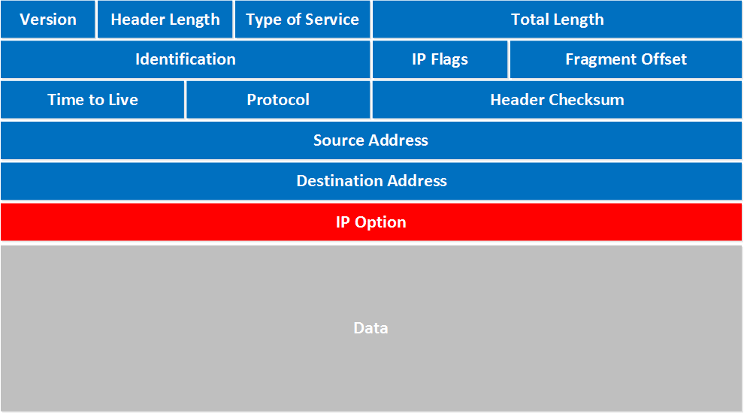
Router:
Visual View IP Packet:

Slide 33
Frame (Layer 2): MAC to MAC, only inside a local network.
Packet (Layer 3): IP to IP, can travel across multiple networks.
Router:
Visual View IP Packet:
Version (4 bits): Says if it’s IPv4 or IPv6. (Here it’s IPv4.)
Header Length (4 bits): Tells how long the header is (minimum 20 bytes).
Type of Service (8 bits): Tells routers how to handle the packet (priority, speed, delay).
Total Length (16 bits): Size of the whole packet (header + data).
Identification, Flags, Fragment Offset:
These three work together when a large packet is split (fragmented) into smaller ones.
Identification: A number to group fragments of the same packet.
Flags: Tells if more fragments follow.
Fragment Offset: Position of this fragment in the original packet.
TTL – Time To Live (8 bits): A countdown value
Protocol (8 bits): Says what’s inside the packet. Example:
6 = TCP
17 = UDP
1 = ICMP
Header Checksum (16 bits): Used to check if the header got corrupted in transit.
Source IP (32 bits): The sender’s IP address.
Destination IP (32 bits): The receiver’s IP address.
Options + Padding (optional): Extra features (rarely used).
Payload (Data): The real content being carried (e.g., a TCP/UDP segment, which has ports and the actual message).

Slide 34
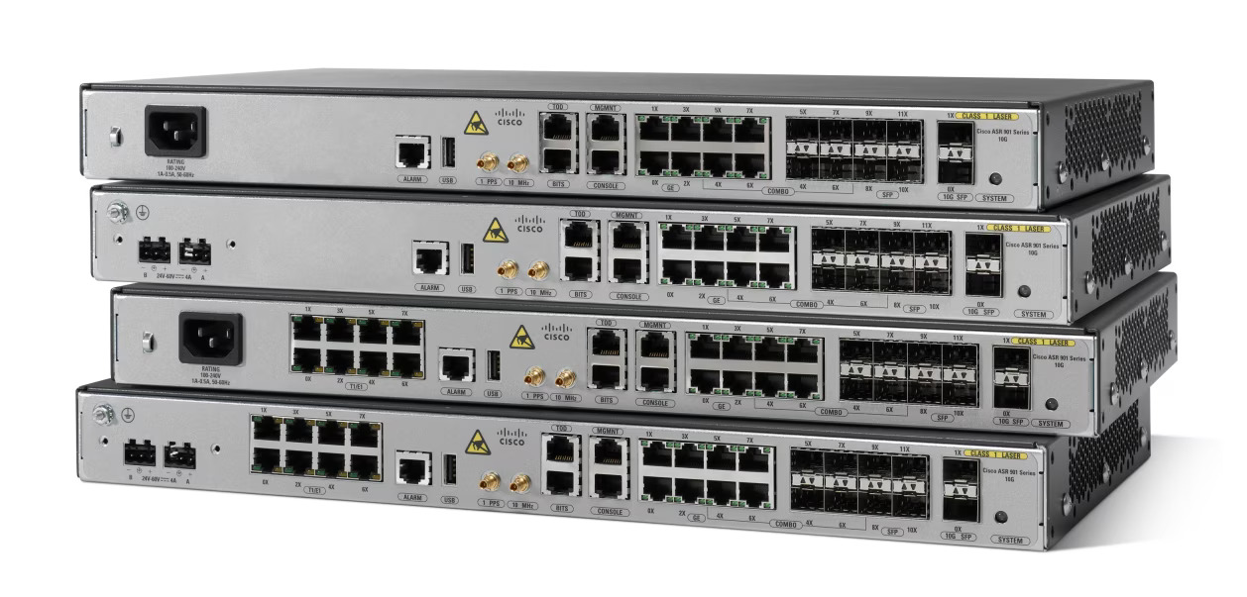

Slide 35
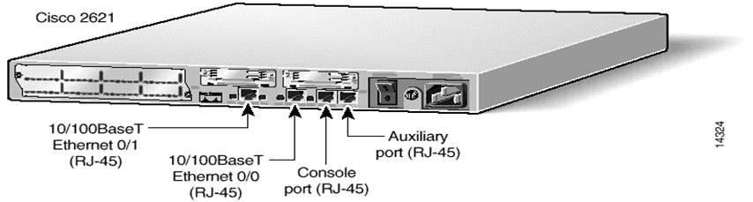
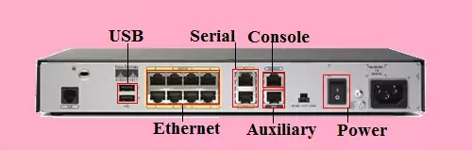
Power Port is used for Power Supply
Power on/off Button is used to turn on the router
Console port is used for router configuration
Aux port is used for remotely accessing the router (It is old method)
Serial Port is used for WAN Connectivity
AUI (Attachment Unit Interface) is used for LAN Connectivity, Switches are connected to this port

Slide 36
Router:
Non-Modular Router:
A fixed hardware router with no upgrade options, ideal for smaller networks.
Cisco 2500 series routers (2500 to 2599) are non-modular routers.
Modular Router:
A router with customizable hardware components for scalability and flexibility.
Cisco 2600 series and above are generally modular routers.

Slide 37
Repeater: Extending the Range of a Wired or Wireless Network
🔸 A repeater is a network device that boosts signals
🔸 It helps data travel longer distances without getting weak
🔸 Used in both wired and wireless networks
Why Use a Repeater?
🔸 Signals lose strength over long distances (called attenuation)
🔸 A repeater receives, amplifies, and retransmits the signal
🔸 Ensures data reaches the destination clearly and reliably
Where is a Repeater Used?
🔸 Large office buildings
🔸Wi-Fi range extension in homes
🔸 Campus networks with long cable runs
How Does a Repeater Work?
🔸 It has two ports (input and output)
🔸 Signal comes in weak, repeater makes it strong again
🔸 Then sends it further down the network

Slide 38
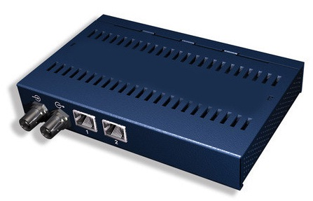
Repeater: Extending the Range of a Wired or Wireless Network

Slide 39
Bridge: Connecting Two Local Networks
🔸A bridge connects two local networks, allowing devices on one network to communicate with devices on the other.
🔸Filters traffic based on MAC addresses
🔸Forwards data only to the correct segment
🔸Helps in dividing a large network into smaller, manageable parts

Slide 40
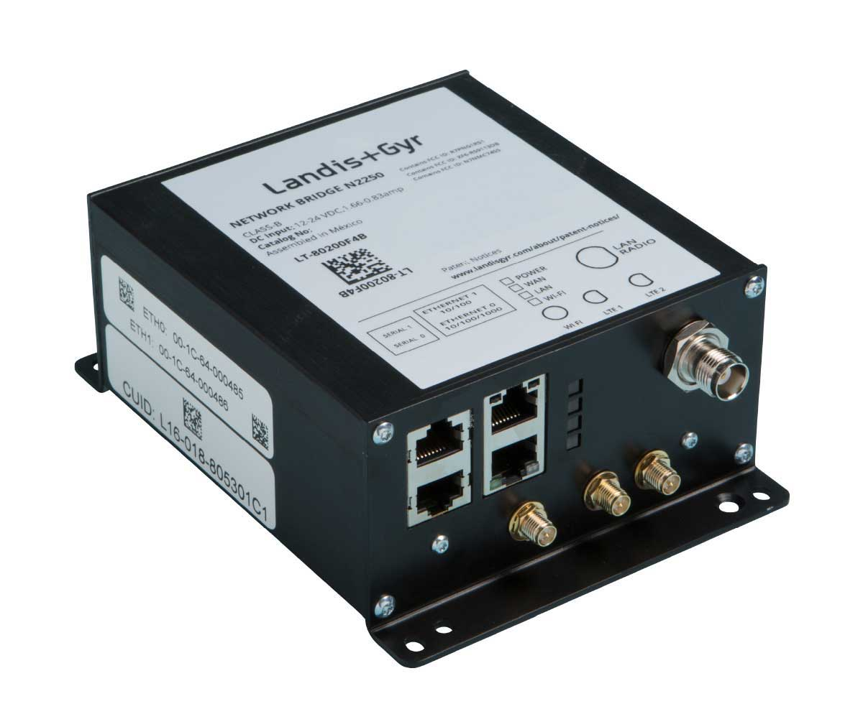
Bridge: Connecting Two Local Networks

Slide 41
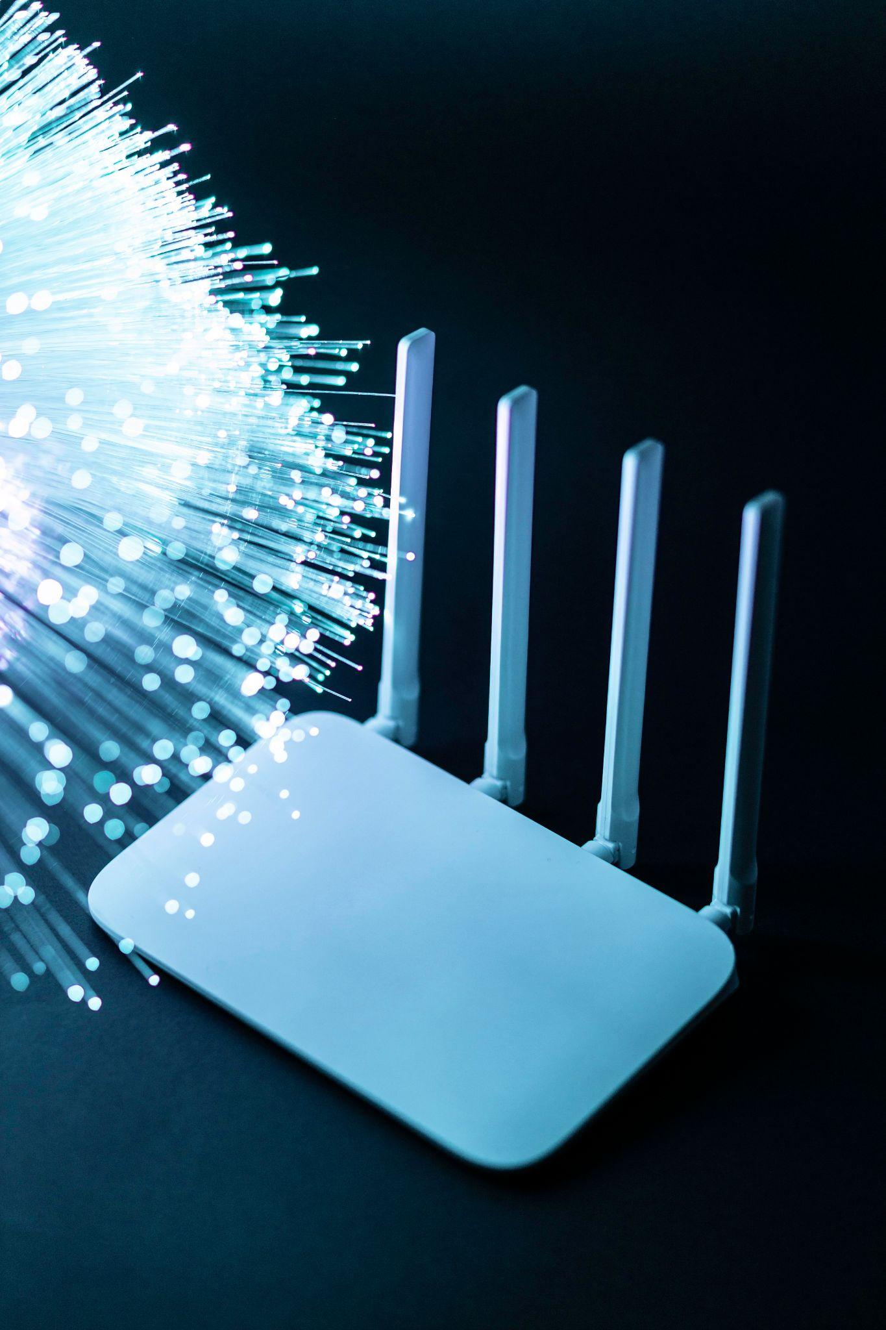
Access Point (AP):

Slide 42
Access Point (AP): Wireless Gateway to a Wired Network
🔸An access point (AP) allows wireless devices to connect to a wired network.
🔸APs broadcast a Wi-Fi signal, creating a wireless network that allows devices to connect and access the internet.
🔸Commonly used in homes, offices, and public places

Slide 43
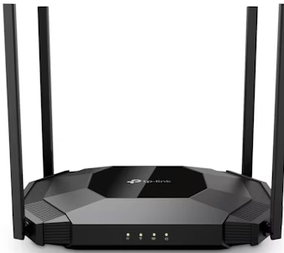
Access Point (AP): Wireless Gateway to a Wired Network

Slide 44
Wireless LAN Controller (WLC): Centralized Management of Wireless Access Points
Centralized Control
A wireless LAN controller (WLC) manages multiple access points (APs), simplifying network configuration and monitoring.
Simplified Management
WLCs provide a single point of control for all wireless APs, making network management more efficient and easier.
Improved Security
WLCs enable advanced security features, like authentication and encryption, to protect wireless networks from unauthorized access.

Slide 45



Firewall:

Slide 46
Firewall:
The basic functionality of a firewall is to allow or block network traffic.
It acts like a security guard for your network.
A firewall is a network security device.
A firewall can be software-based or hardware-based.
A firewall can be host-based or network-based.
A firewall can also function as a router.
Advanced firewalls include features like IPS (Intrusion Prevention System) and IDS (Intrusion Detection System).
Many firewalls also support VPN (Virtual Private Network) capabilities.
Some firewalls offer load balancing features as well.
Firewalls can perform deep packet inspection (DPI).
Firewalls often include a DMZ (Demilitarized Zone) for isolating publicly accessible services.
Popular firewall vendors include Cisco ASA, Huawei, Juniper, Palo Alto, Fortinet (FortiGate), and Check Point.
A WAF (Web Application Firewall) protects websites by filtering and blocking malicious web traffic.
The main functionality of a firewall is to allow or block network traffic.

Slide 47
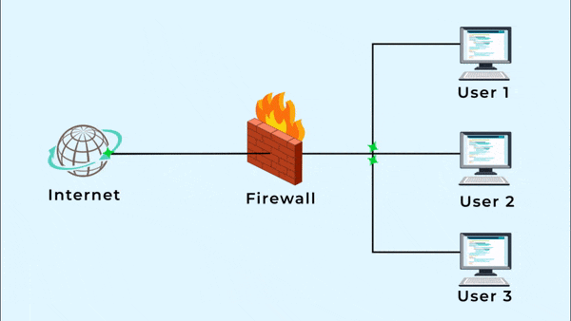
Firewall:

Slide 48
Intrusion Prevention System (IPS)
IPS is a network security tool that detects and blocks threats in real time.
It actively monitors network traffic for suspicious or malicious activity.
When a threat is found, IPS can automatically block, drop, or reset the connection..
Function:
Combines detection and prevention.
Stops threats before they impact systems.
Integrates with firewalls, IDS, and antivirus solutions.

Slide 49
Endpoints
Servers
Devices (e.g., computers, mobile devices) connected to a network.
Devices such as computers, smartphones, and IoT devices connected to a network.
Centralized systems that store, process, and manage data for network users.
They host applications, databases, and provide services like email or file sharing.

Slide 50
Types of Network Communication
Unicast
One to one communication
Communication between a single sender and a single receiver.
Used in regular internet browsing, emails, and one-to-one communication.
Example: A user accessing a website
Multicast
One to many or to a special group
Communication where data is sent from one sender to multiple specific receivers in a group.
Used in streaming services, video conferencing
A live video stream sent to selected users
Broadcast
One to all communication
Communication where data is sent from one sender to all devices on the network.
Used in ARP requests, DHCP, and network discovery.
A DHCP request
Anycast
One-to-one-of-many communication.
Data is sent to the nearest or best receiver in a group (based on routing distance).
You have one address, like 8.8.8.8
But that address is used by many servers around the world
When you send data to that address, it automatically goes to the closest server to you

Slide 51
IP Addresses: Unique Identifiers for Network Devices
IP : Internet Protocol
Protocol: A protocol is a set of rules and regulations used for communication.
✅ Common Alternative Names for IP Address:
Logical Address
Network Address
Internet Address
Host Address.
Layer 3 Address
IPv4/IPv6 Address
Assigned Address

Slide 52
IP Addresses: Unique Identifiers for Network Devices
IP (Internet Protocol) is like the address system of the internet.
IP is like the postal system of the internet. 📬
Every device connected to a network has a unique IP address, like a digital house number.
IP addresses enable routers and switches to identify and route data packets to the correct destination.
They are crucial for internet communication, allowing devices to find and communicate with each other.
Example: If you're watching a video or browsing a website, your device uses IP to find and talk to the server where the video or website is stored.
Example: Just like your house has a unique address so people can send you letters, every device (computer, mobile, etc.) on the internet has a unique IP address so data can reach the right place.

Slide 53
IP Addresses: Unique Identifiers for Network Devices
There are two versions of the Internet Protocol (IP):
IPv4: (Internet Protocol Version 4)
IPv6: (Internet Protocol Version 6)
Feature | IPv4 | IPv6
Full Form | Internet Protocol Version 4 | Internet Protocol Version 6
Bit Length | 32-bit | 128-bit
Format | Decimal | Hexadecimal
Structure | 4 octets (each octet = 1 byte) | 8 groups (each group = 2 bytes)
Total Size | 4 bytes | 16 bytes
Separator | Dots (.) | Colons (:)
Example | 192.168.1.1 | 2001:0db8:85a3:0000:0000:8a2e:0370:7334

Slide 54
Difference b/w Public IP and Private IP
Private IP
Public IP
1
Private IP is used with in LAN Network
With in organization
1
Public IP is used for Public Network
Not Recognized on the internet
2
Public IP recognized on Internet
2
3
Private IP given by the Administrator
Public IP is given by the IANA/Service Provider
3
Free Available
4
Not Free
4
5
Un Registered
5
Public IP is Registered

Slide 55
Difference between Pubic IP and Private IP
Public IP Address: A unique internet address assigned by your ISP to identify your device online. It allows communication across the internet and is essential for servers and services accessible worldwide.
Private IP Address: An address used within your home or office network for internal communication. It can't connect directly to the internet and uses NAT to share a public IP for online access.
Private IP Address Ranges (RFC 1918):
Class A: 10.0.0.0–10.255.255.255 (16.7M addresses, Subnet: 255.0.0.0)
Class B: 172.16.0.0–172.31.255.255 (1M addresses, Subnet: 255.240.0.0)
Class C: 192.168.0.0–192.168.255.255 (65K addresses, Subnet: 255.255.0.0)
Public IP Address Ranges:
Any IP not in private ranges or reserved (e.g., 8.8.8.8, 13.107.42.16).

Slide 56
Difference between Pubic and Private Network
Public Network: Your PC is hidden from other devices on the network and cannot be used for printer or file sharing. This is ideal for unsecured or public places like cafes and airports.
Private Network: Used for trusted networks, such as home or work. Your PC is discoverable and can be used for printer and file sharing if configured properly.

Slide 57
IP Address Classes
Class | Range | Usage | Network Portion / Host Portion | Default Subnet Mask
A | 1.0.0.0 - 126.255.255.255 | Large networks, ISPs | Network: 8 bits / Host: 24 bits | 255.0.0.0
B | 128.0.0.0 - 191.255.255.255 | Medium-sized networks | Network: 16 bits / Host: 16 bits | 255.255.0.0
C | 192.0.0.0 - 223.255.255.255 | Small networks | Network: 24 bits / Host: 8 bits | 255.255.255.0
D | 224.0.0.0 - 239.255.255.255 | Multicast addresses | Not applicable | Not applicable
E | 240.0.0.0 - 255.255.255.255 | Experimental purposes | Not applicable | Not applicable
This table is designed by IANA,
IANA is Internet Assigning numbering Authority

Slide 58
IP Addresses: Unique Identifiers for Network Devices
IPv4: (Internet Protocol Version 4)
1 Octet =1 byte = 8 bits
192 . 168 . 1 . 100 = 32 bits
1 byte + 1 byte + 1 byte + 1 byte = 32 bits
1 octet + 1 octet + 1 octet + 1 octet = 32 bits
8 bits + 8 bits + 8 bits + 8 bits = 32 bits

Slide 59
IP Addresses: Unique Identifiers for Network Devices
IPv6: (Internet Protocol Version 6)
1 Group: 2 bytes = 16 bits
2001:0db8:85a3:0000:0000:8a2e:0370:7334= 128 bits in total
2 bytes × 8 groups = 16 bytes
16 bits × 8 groups = 128 bits
What is a Bit?
A bit (short for binary digit) is the smallest unit of data in computing.

Slide 60
IP Addresses: Unique Identifiers for Network Devices
Subnet Mask:
Used in IP addressing to define which part of the IP address is Network and which part is host
Example: 255.255.255.0 ➔ Means first 3 octet are network , last one octet is host
Example : 255.255.0.0 ➔ Means first 2 octet are network , last 2 octet are host
Example: 255.0.0.0 ➔ Means first octet is network , last 3 octet are host
Class A : IP 192.168.1.1
Default Subnet Mask : 255.255.255.0 ➔ Means first 3 octet are network , last one octet is host
Class B : IP 172.168.1.1
Default Subnet Mask : 255.255.0.0 ➔ Means first 2 octet are network , last 2 octet are host
Class C : IP 10.10.10.1
Default Subnet Mask : 255.0.0.0 ➔ Means first octet is network , last 3 octet are host

Slide 61
Examples:
Suppose you have Class A IP = 40.40.20.20 ,Find its
Network ID ?
Broad cast ID?
Subnet ID ?
Solution:
40.40.20.20
Host Portion
Network Portion
40.0.0.0 Network ID
40.255.255.255 Broad cast ID
255.0.0.0 Subnet ID

Slide 62
Examples:
Suppose you have Class A IP = 100.100.100.100 ,Find its
Network ID ?
Broad cast ID?
Subnet ID ?
Solution:
100.100.100.100
Network Portion
Host Portion
100.0.0.0 Network ID
100.255.255.255 Broad cast ID
255.0.0.0 Subnet ID

Slide 63
Examples:
Suppose you have Class B IP = 172.168.100.100 ,Find its
Network ID ?
Broad cast ID?
Subnet ID ?
Solution:
172.168.100.100
Network Portion
Host Portion
172.168.0.0 Network ID
172.168.255.255 Broad cast ID
255.255.0.0 Subnet ID

Slide 64
Examples:
Suppose you have Class C IP = 192.168.1.100 ,Find its
Network ID ?
Broad cast ID?
Subnet ID ?
Solution:
192.168.1.100
Network Portion
Host Portion
192.168.1.0 Network ID
192.168.1.255 Broad cast ID
255.255.255.0 Subnet ID

Slide 65
Assignment:
Class A
10.10.10.20
20.10.10.10
50.10.10.10
90.90.99.99
80.80.80.80
100.200.100.100
110.110.110.200
Class B
177.200.100.100
180.200.100.100
190.100.190.100
186.168.168.160
150.100.100.150
140.140.200.100
170.160.128.100
Class C
193.160.200.100
194.194.200.100
196.168.168.100
200.100.200.100
210.100.210.210
211.211.211.211
213.100.100.200
Find the:
Network ID ?
Broad cast ID?
Subnet ID ?

Slide 66
Subnetting
Binary to Decimal and Decimal to Binary Conversion:
128 64 32 16 8 4 2 1
Find Binary of 127 ?
0 1 1 1 1 1 1 1 = 27
Find Binary of 128?
1 0 0 0 0 0 0 0=128
Find Binary of 255?
1 1 1 1 1 1 1 1=255
Find Binary of 191?
1 0 1 1 1 1 1 1=191

Slide 67
Subnetting
Assignment : Convert to Binary
Class A:
1
5
10
25
27
50
65
99
120
126
Class B:
128
130
135
150
160
170
175
180
190
191
Class C:
192
195
200
202
207
210
215
219
221
223
Class D:
224
226
228
230
232
234
236
237
238
239
Class E:
240
242
244
246
248
250
251
253
254
255

Slide 68
Subnetting
Assignment: Convert IP Addresses to Binary
Class A IPs:
10.0.0.1
25.100.50.5
50.10.1.100
99.200.15.2
126.1.2.3
Class B IPs:
128.100.1.1
150.10.50.25
172.16.5.5
180.80.20.10
191.255.0.100
Class C IPs:
192.168.1.1
200.100.20.15
210.50.50.50
220.10.10.10
223.255.255.254
Class D IPs:
224.0.0.1
230.10.10.10
235.1.1.1
238.100.100.10
239.255.0.0
Class E IPs:
Range: 240.0.0.0 to 255.255.255.255
Purpose: Reserved for experimental or research use only
Not assigned to hosts or used in normal IP addressing
Not routable over the public internet
Not used in real-world networking for devices
✅ Example 1 : 10.0.0.1
00001010.00000000.00000000.00000001

Slide 69
Subnetting
What is Subnetting?
Subnetting is the process of dividing a large network into smaller subnetworks to efficiently use IP addresses.
It helps in better network management, security, and reducing IP wastage.
Why Do We Need Subnetting?
Efficient Use of IP Addresses – Prevents wastage of IPs.
Solves IP Shortage – Helps in managing limited IP resources.
Improves Network Performance – Reduces congestion by segmenting traffic.
Enhances Security – Allows better control and isolation of network segments.
Note: The RIPv1 protocol is unable to handle subnetted IPs properly, whereas RIPv2 and OSPF can. In these practical we will be using RIPv2.

Slide 70
Subnetting
Two types of Subnetting
FLSM (Fixed of length subnet mask)
VLSM (Variable length subnet mask)
FLSM:
Fixed Length Subnet Mask
All subnets have same subnet mask.
Equal number of IPs in each subnet.
Easier to design, but wastes IPs.
FLSM look or users(Hosts) , all subnets will have the same number of hosts
VLSM:
Variable Length Subnet Mask
Subnets can have different sizes/masks.
IPs are used efficiently, no waste.
Needs proper planning and routing.
VLSM looks for both , first network and then users , Assign subnet size based on user needs

Slide 71
Subnetting
FLSM using Class C:

Slide 72
Subnetting
Q1: A company says, "We have purchased the IP address 210.200.100.100/24. You need to connect two branches, and each branch has 126 users”.
128 64 32 16 8 4 2 1
Left to right (User)
26 − 2 = >4
=>126
2128 -2=> Billion -2
264 -2=> Billion -2
232 -2=> Many -2
216 -2=> Many -2
28 -2=256-2=> 254
27 -2= 128-2=>126 (Satisfied)
n=7 host bits required
-2
1 IP is used for the network address.
1 IP is used for the broadcast address.
Subtract the 2 addresses for network and broadcast (128 - 2 = 126). 126 are the usable IPs you can use

Slide 73
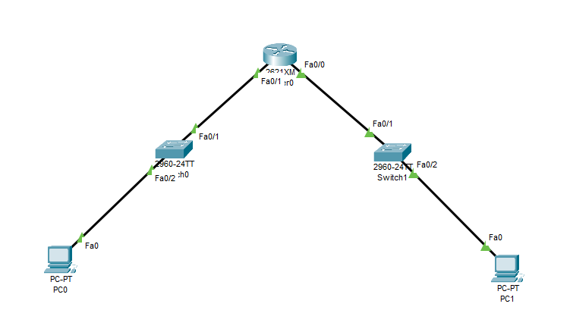


Subnetting
IP: 210.200.100.100/24
210.200.100.2
255.255.255.128
210.200.100.130
255.255.255.128

Slide 74
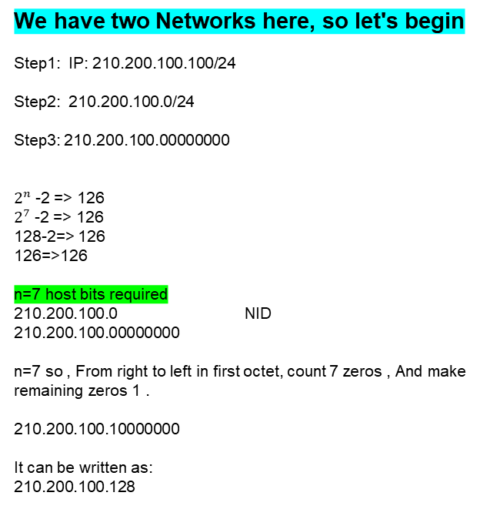
Subnetting
IP: 210.200.100.100/24
We have two Networks here, so let's begin
Step1: IP: 210.200.100.100/24
Step2: 210.200.100.0/24
Step3: 210.200.100.00000000
$2^{n}$ -2 => 126
$2^{7}$ -2 => 126
128-2=> 126
126=>126
n=7 host bits required
210.200.100.0 NID
210.200.100.00000000
n=7 so , From right to left in first octet, count 7 zeros , And make remaining zeros 1 .
210.200.100.10000000
It can be written as:
210.200.100.128
First Subnetwork:
Network ID: 210.200.100.0/25
Usable Range: 210.200.100.1 – 210.200.100.126
Broadcast ID: 210.200.100.127
Subnet Mask: 255.255.255.128
2nd Subnetwork:
For 2nd network, always look for the first zero when turned to 1 , note that , and its decimal value will be the start of 2nd subnetwork.
Network ID: 210.200.100.128/25
Usable Range: 210.200.100.129 – 210.200.100.254
Broadcast ID: 210.200.100.255
Subnet Mask: 255.255.255.128

Slide 75
Subnetting
IP: 210.200.100.100/24
First Subnetwork:
Network ID: 210.200.100.0/25
Broadcast ID: 210.200.100.127
Subnet Mask: 255.255.255.128
Usable Range: 210.200.100.1 – 210.200.100.126
2nd Subnetwork:
Network ID: 210.200.100.128/25
Broadcast ID: 210.200.100.255
Subnet Mask: 255.255.255.128
Usable Range: 210.200.100.129 – 210.200.100.254
210.200.100.1
210.200.100.129
210.200.100.2
255.255.255.128
210.200.100.130
255.255.255.128

Slide 76
Subnetting
IP: 210.200.100.100/24
Q1: Practical
Router> enable
Router# configure terminal
Router(config)# interface FastEthernet0/0
Router(config-if)# ip address 210.200.100.1 255.255.255.128
Router(config-if)# no shutdown
Router(config-if)# exit
Router(config)# interface FastEthernet0/1
Router(config-if)# ip address 210.200.100.129 255.255.255.128
Router(config-if)# no shutdown
Router(config-if)# exit

Slide 78
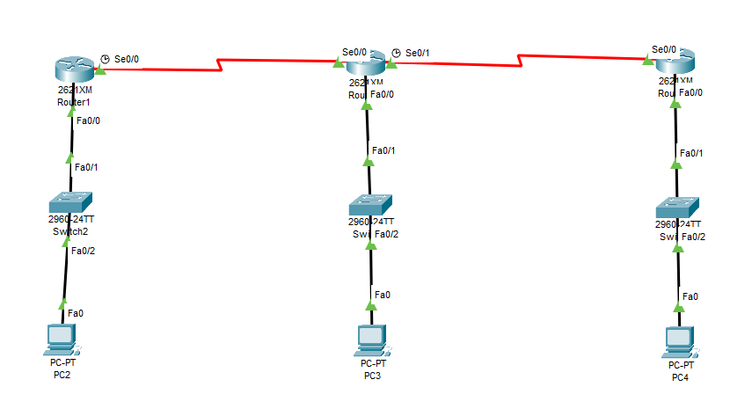





Subnetting
Q2: Company bought an IP 192.168.100.200/24 , company says connect 3 branches and connect 4 users each branch. Using FLSM and using RIPv2.
Network 4
Network 5
Network 1
Network 3
Network 2

Slide 79
Subnetting
Here we have 5 Network, so let's begin
First Subnetwork:
Network ID: 192.168.100.0/29
Broadcast: 192.168.100.7
Mask: 255.255.255.248
Usable hosts: 192.168.100.1 → 192.168.100.6
2nd Subnetwork:
Network ID: 192.168.100.8/29
Broadcast: 192.168.100.15
Mask: 255.255.255.248
Usable hosts: 192.168.100.9 → 192.168.100.14
3rd Subnetwork:
Network ID: 192.168.100.16/29
Broadcast: 192.168.100.23
Mask: 255.255.255.248
Usable hosts: 192.168.100.17 → 192.168.100.22
4th Subnetwork:
Network ID: 192.168.100.24/29
Broadcast: 192.168.100.31
Mask: 255.255.255.248
Usable hosts: 192.168.100.17 → 192.168.100.22
5th Subnetwork:
Network ID: 192.168.100.32/29
Broadcast: 192.168.100.39
Mask: 255.255.255.248
Usable hosts: 192.168.100.33 → 192.168.100.38
Step 1: IP: 192.168.100.200/24
Step 2: 192.168.100.0 NID
Step 3: 192.168.100.00000000
2³ − 2 = >4
8-2=>4
6=>4 (Satisfied)
n = 3 host bits required.
Step 3: 192.168.100.00000000
n=3 so , From right to left in first octet, count 3 zeros , And make remaining zeros 1
192.168.100.11111000
It can be written as:
192.168.100.248
Subnet mask = 255.255.255.248

Slide 80
Subnetting
Q2: Practical, Using RIPv2
192.168.100.17
192.168.100.32
192.168.100.33
192.168.100.18
192.168.100.9
192.168.100.17
192.168.100.1
192.168.100.2
255.255.255.248
192.168.100.10
255.255.255.248
192.168.100.18
255.255.255.248

Slide 81
Subnetting
Q2: Practical,Using RIPv2
R1
Router> enable
Router# configure terminal
Router(config)# interface FastEthernet0/0
Router(config-if)# ip address 192.168.100.1 255.255.255.248
Router(config-if)# no shutdown
Router(config-if)# exit
Router(config)# interface Serial0/0
Router(config-if)# ip address 192.168.100.17 255.255.255.248
Router(config-if)# no shutdown
Router(config-if)# exit
Router(config)# router rip
Router(config-router)# version 2
Router(config-router)# network 192.168.100.0
Router(config-router)# no auto-summary
Router(config-router)# exit
Router(config)# exit
Router#
R2
Router> enable
Router# configure terminal
Router(config)# interface FastEthernet0/0
Router(config-if)# ip address 192.168.100.9 255.255.255.248
Router(config-if)# no shutdown
Router(config-if)# exit
Router(config)# interface Serial0/0
Router(config-if)# ip address 192.168.100.18 255.255.255.248
Router(config-if)# no shutdown
Router(config-if)# exit
Router(config)# interface Serial0/1
Router(config-if)# ip address 192.168.100.32 255.255.255.248
Router(config-if)# no shutdown
Router(config-if)# exit
Router(config)# router rip
Router(config-router)# version 2
Router(config-router)# network 192.168.100.0
Router(config-router)# no auto-summary
Router(config-router)# exit
Router(config)# exit
Router#

Slide 82
Subnetting
Q2: Practical, Using RIPv2
R3
Router> enable
Router# configure terminal
Router(config)# interface FastEthernet0/0
Router(config-if)# ip address 192.168.100.17 255.255.255.248
Router(config-if)# no shutdown
Router(config-if)# exit
Router(config)# interface Serial0/0
Router(config-if)# ip address 192.168.100.33 255.255.255.248
Router(config-if)# no shutdown
Router(config-if)# exit
Router(config)# router rip
Router(config-router)# version 2
Router(config-router)# network 192.168.100.0
Router(config-router)# no auto-summary
Router(config-router)# exit
Router(config)# exit
Router#
no auto-summary in RIP is used to stop RIP from shortening routes and instead send the full subnet information

Slide 84
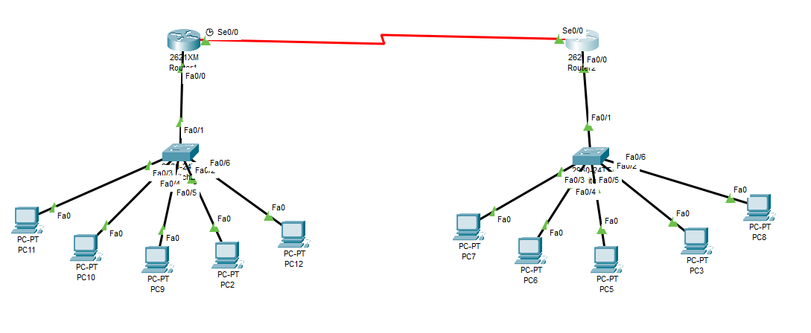



Subnetting
Q3: Company bought an IP 192.168.1.100/24 , company says connect 2 branches and connect 5 users each branch. Using FLSM and using RIPv2
Network 3
Network 2
Network 1

Slide 85
Subnetting
Here we have 3 Network, so let's begin
Step 1: IP: 192.168.1.100/24
Step 2: 192.168.1.0 NID
Step 3: 192.168.1.00000000
2³ − 2 = >4
8-2=>4
6=>4 (Satisfied)
n = 3 host bits required.
Step 3: 192.168.1.00000000
n=3 so , From right to left in first octet, count 3 zeros , And make remaining zeros 1
192.168.1.11111000
It can be written as:
192.168.1.248
Subnet mask = 255.255.255.248
First Subnetwork:
Network ID: 192.168.1.0/29
Broadcast: 192.168.1.7
Mask: 255.255.255.248
Usable hosts: 192.168.1.1 → 192.168.1.6
2nd Subnetwork:
Network ID: 192.168.1.8/29
Broadcast: 192.168.1.15
Mask: 255.255.255.248
Usable hosts: 192.168.1.9 → 192.168.1.14
3rd Subnetwork:
Network ID: 192.168.1.16/29
Broadcast: 192.168.1.23
Mask: 255.255.255.248
Usable hosts: 192.168.1.17 → 192.168.1.22

Slide 86
Subnetting
Q3: Practical
192.168.1.17
192.168.1.18
192.168.1.1
192.168.1.9

Slide 87
Subnetting
Practical 3: Using RIPv2
Router A
Router> enable
Router# configure terminal
Router(config)# interface FastEthernet0/0
Router(config-if)# ip address 192.168.1.1 255.255.255.248
Router(config-if)# no shutdown
Router(config-if)# exit
Router(config)# interface Serial0/0
Router(config-if)# ip address 192.168.1.17 255.255.255.248
Router(config-if)# no shutdown
Router(config-if)# exit
Router(config)# router rip
Router(config-router)# version 2
Router(config-router)# network 192.168.1.0
Router(config-router)# no auto-summary
Router(config-router)# exit
Router#
Router B
Router> enable
Router# configure terminal
Router(config)# interface FastEthernet0/0
Router(config-if)# ip address 192.168.1.9 255.255.255.248
Router(config-if)# no shutdown
Router(config-if)# exit
Router(config)# interface Serial0/0
Router(config-if)# ip address 192.168.1.18 255.255.255.248
Router(config-if)# no shutdown
Router(config-if)# exit
Router(config)# router rip
Router(config-router)# version 2
Router(config-router)# network 192.168.1.0
Router(config-router)# no auto-summary
Router(config-router)# exit
Router#
no auto-summary in RIP is used to stop RIP from shortening routes and instead send the full subnet information

Slide 89
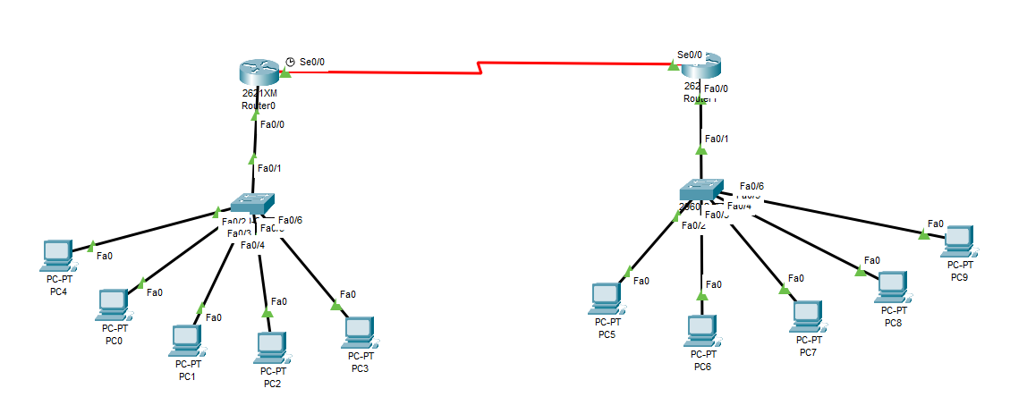



Subnetting
Practical 4 using OSPF:
Q: Company bought an IP 210.200.100.100/24 , company says connect 2 branches and connect 5 users each branch. Using FLSM.
Network 3
Network 2
Network 1

Slide 90
Subnetting
IP: 210.200.100.100/24
Here we have 3 Network, so let's begin
Step 1: IP: 210.200.100.100/24
Step 2: 210.200.100.0 NID
Step 3: 210.200.100.00000000
2³ − 2 = >5
8-2=>5
6=>5 (Satisfied)
n=3
Step 3: 210.200.100.00000000
n=3 so , From right to left in first octet, count 3 zeros , And make remaining zeros 1
210.200.100.11111000
It can be written as:
210.200.100.248
Subnet mask = 255.255.255.248
First Subnetwork:
Network ID: 210.200.100.0/29
Usable Range: 210.200.100.1 – 210.200.100.6
Broadcast ID: 210.200.100.7
Subnet Mask: 255.255.255.248
2nd Subnetwork:
For 2nd network, always look for the first zero when turned to 1 , note that , and its decimal value will be the start of 2nd subnetwork.
Network ID: 210.200.100.8/29
Usable Range: 210.200.100.9 – 210.200.100.14
Broadcast ID: 210.200.100.15
Subnet Mask: 255.255.255.248
3rd Subnetwork:
Network ID: 210.200.100.16/29
Usable Range: 210.200.100.17 – 210.200.100.22
Broadcast ID: 210.200.100.23
Subnet Mask: 255.255.255.248

Slide 91



Subnetting
Practical 4 using OSPF:
210.200.100.17
Network 3
210.200.100.18
210.200.100.1
210.200.100.9
Network 2
Network 1

Slide 92
Subnetting
Practical 4 using OSPF:
Router A
Router> enable
Router# configure terminal
Router(config)# interface FastEthernet0/0
Router(config-if)# ip address 210.200.100.1 255.255.255.248
Router(config-if)# no shutdown
Router(config-if)# exit
Router(config)# interface Serial0/0
Router(config-if)# ip address 210.200.100.17 255.255.255.248
Router(config-if)# no shutdown
Router(config-if)# exit
Router(config)# router ospf 1
Router(config-router)# network 210.200.100.0 0.0.0.7 area 0
Router(config-router)# exit
Router#
Router B
Router> enable
Router# configure terminal
Router(config)# interface FastEthernet0/0
Router(config-if)# ip address 210.200.100.9 255.255.255.248
Router(config-if)# no shutdown
Router(config-if)# exit
Router(config)# interface Serial0/0
Router(config-if)# ip address 210.200.100.18 255.255.255.248
Router(config-if)# no shutdown
Router(config-if)# exit
Router(config)# router ospf 1
Router(config-router)# network 210.200.100.0 0.0.0.7 area 0
Router(config-router)# exit
Router#
Wildcard Mask calculation:
Global Subnet Mask - Sub netmask
255.255.255.255 - 255.255.255.248 = 0.0.0.7

Slide 93
Subnetting
Other Practical:
Assignment:
Class C:
193.193.100.100/24, Connect 3 branches , 60 users each
200.100.100.100/24, Connect 4 branches, 50 users each
210.100.50.60/24, Connect 7 branches , 20 users each
210.200.30.60/24, Connect 2 branches , 30 users each

Slide 94
Subnetting
FLSM using Class B:

Slide 95
Subnetting
Q1: Company bought an IP 172.168.100.100/16 , company says connect 3 branches and connect 26 users each branch. Using FLSM and using RIPv2.
Network 4
Network 5
Network 1
Network 3
Network 2

Slide 96
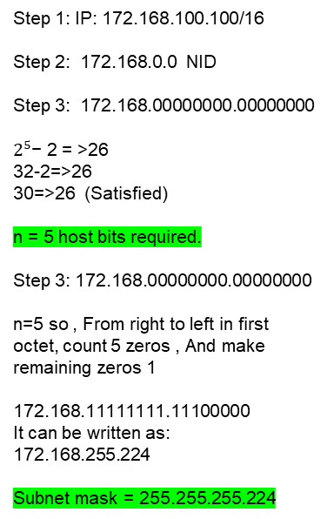
Subnetting
Here we have 5 Network, so let's begin
First Subnetwork:
Network ID: 172.168.0.0/27
Broadcast: 172.168.0.31/27
Mask: 255.255.255.224
Usable hosts: 172.168.0.1 → 172.168.0.30
2nd Subnetwork:
Network ID: 172.168.0.32/2
Broadcast: 172.168.0.63
Mask: 255.255.255.224
Usable hosts: 172.168.0.33 – 172.168.0.62
3rd Subnetwork:
Network ID: 172.168.0.64/27
Broadcast: 172.168.0.95
Mask: 255.255.255.224
Usable hosts: 172.168.0.65 – 172.168.0.94
4th Subnetwork:
Network ID: 172.168.0.96/27
Broadcast: 172.168.0.127
Mask: 255.255.255.224
Usable hosts: 172.168.0.97 – 172.168.0.126
5th Subnetwork:
Network ID: 172.168.0.128/27
Broadcast: 172.168.0.159
Mask: 255.255.255.248
Usable hosts: 172.168.0.129 – 172.168.0.158
Step 1: IP: 172.168.100.100/16
Step 2: 172.168.0.0 NID
Step 3: 172.168.00000000.00000000
$2^{5}$− 2 = >26
32-2=>26
30=>26 (Satisfied)
n = 5 host bits required.
Step 3: 172.168.00000000.00000000
n=5 so , From right to left in first octet, count 5 zeros , And make remaining zeros 1
172.168.11111111.11100000
It can be written as:
172.168.255.224
Subnet mask = 255.255.255.224

Slide 97
Subnetting
Q1: Practical, Using RIPv2
172.168.0.97
172.168.0.129
172.168.0.130
172.168.0.98
172.168.0.33
172.168.0.65
172.168.0.1
172.168.0.2
255.255.255.224
172.168.0.34
255.255.255.224
172.168.0.66
255.255.255.224

Slide 98
Subnetting
Q1: Practical,Using RIPv2
R1
Router> enable
Router# configure terminal
Router(config)# interface FastEthernet0/0
Router(config-if)# ip address 172.168.0.1 255.255.255.224
Router(config-if)# no shutdown
Router(config-if)# exit
Router(config)# interface Serial0/0
Router(config-if)# ip address 172.168.0.97 255.255.255.224 Router(config-if)# no shutdown
Router(config-if)# exit
Router(config)# router rip
Router(config-router)# version 2
Router(config-router)# network 172.168.0.0
Router(config-router)# no auto-summary
Router(config-router)# exit
Router(config)# exit
Router#
R2
Router> enable
Router# configure terminal
Router(config)# interface FastEthernet0/0
Router(config-if)# ip address 172.168.0.33 255.255.255.224
Router(config-if)# no shutdown
Router(config-if)# exit
Router(config)# interface Serial0/0
Router(config-if)# ip address 172.168.0.98 255.255.255.248
Router(config-if)# no shutdown
Router(config-if)# exit
Router(config)# interface Serial0/1
Router(config-if)# ip address 172.168.0.129 255.255.255.248
Router(config-if)# no shutdown
Router(config-if)# exit
Router(config)# router rip
Router(config-router)# version 2
Router(config-router)# network 172.168.0.0
Router(config-router)# no auto-summary
Router(config-router)# exit
Router(config)# exit
Router#

Slide 99
Subnetting
Q1: Practical, Using RIPv2
R3
Router> enable
Router# configure terminal
Router(config)# interface FastEthernet0/0
Router(config-if)# ip address 172.168.0.65 255.255.255.224 Router(config-if)# no shutdown
Router(config-if)# exit
Router(config)# interface Serial0/0
Router(config-if)# ip address 172.168.0.130 255.255.255.248
Router(config-if)# no shutdown
Router(config-if)# exit
Router(config)# router rip
Router(config-router)# version 2
Router(config-router)# network 172.168.0.0
Router(config-router)# no auto-summary
Router(config-router)# exit
Router(config)# exit
Router#
no auto-summary in RIP is used to stop RIP from shortening routes and instead send the full subnet information

Slide 100
Subnetting
Other Practical:
Assignment:
Class B:
172.168.100.100/16, Connect 5 Branches , 26 Users each
172.168.100.90/16, Connect 3 Branches , 60 Users each
172.168.10.20/16, Connect 4 Branches , 50 Users each
128.150.100.100/16, Connect 7 Branches , 20 Users each
130.160.50.60/16, Connect 2 Branches , 118 users each

Slide 102
Subnetting
FLSM using Class A:

Slide 103





Subnetting
Q1: Company bought an IP 10.10.10.10 , company says connect 3 branches and connect 56 branches users each branch. Using FLSM and using RIPv2.
Network 4
Network 5
Network 1
Network 3
Network 2

Slide 104
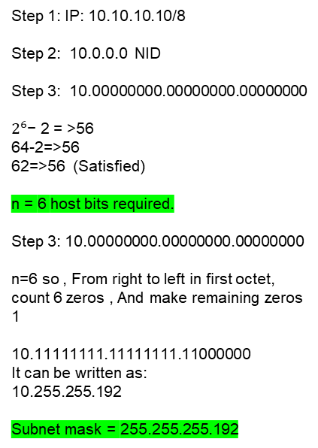
Subnetting
Here we have 5 Network, so let's begin
First Subnetwork:
Network ID: 10.0.0.0/26
Broadcast: 10.0.0.63
Mask: 255.255.255.192
Usable hosts: 10.0.0.1 – 10.0.0.62
2nd Subnetwork:
Network ID: 10.0.0.64/26
Broadcast: 10.0.0.127
Mask: 255.255.255.192
Usable hosts: 10.0.0.65 – 10.0.0.126
3rd Subnetwork:
Network ID: 10.0.0.128/26
Broadcast: 10.0.0.191
Mask: 255.255.255.192
Usable hosts: 10.0.0.129 – 10.0.0.190
4th Subnetwork:
Network ID: 10.0.0.192/26
Broadcast: 10.0.0.255
Mask: 255.255.255.192
Usable hosts: 10.0.0.193 – 10.0.0.254
5th Subnetwork:
Network ID: 10.0.1.0/26
Broadcast: 10.0.1.63
Mask: 255.255.255.192
Usable hosts: 10.0.1.1 – 10.0.1.62
Step 1: IP: 10.10.10.10/8
Step 2: 10.0.0.0 NID
Step 3: 10.00000000.00000000.00000000
$2^{6}$− 2 = >56
64-2=>56
62=>56 (Satisfied)
n = 6 host bits required.
Step 3: 10.00000000.00000000.00000000
n=6 so , From right to left in first octet, count 6 zeros , And make remaining zeros 1
10.11111111.11111111.11000000
It can be written as:
10.255.255.192
Subnet mask = 255.255.255.192

Slide 105
Subnetting
Q1: Practical, Using RIPv2
10.0.0.193
10.0.1.1
10.0.1.2
10.0.0.194
10.0.0.1
10.0.0.65
10.0.0.129
10.0.0.2
255.255.255.192
10.0.0.66
255.255.255.192
10.0.0.130
255.255.255.192

Slide 106
Subnetting
Q1: Practical,Using RIPv2
R1
Router> enable
Router# configure terminal
Router(config)# interface FastEthernet0/0
Router(config-if)# ip address 10.0.0.1 255.255.255.192
Router(config-if)# no shutdown
Router(config-if)# exit
Router(config)# interface Serial0/0
Router(config-if)# ip address 10.0.0.193 255.255.255.192 Router(config-if)# no shutdown
Router(config-if)# exit
Router(config)# router rip
Router(config-router)# version 2
Router(config-router)# network 10.0.0.0
Router(config-router)# no auto-summary
Router(config-router)# exit
Router(config)# exit
Router#
R2
Router> enable
Router# configure terminal
Router(config)# interface FastEthernet0/0
Router(config-if)# ip address 10.0.0.65 255.255.255.192
Router(config-if)# no shutdown
Router(config-if)# exit
Router(config)# interface Serial0/0
Router(config-if)# ip address 10.0.0.194 255.255.255.192
Router(config-if)# no shutdown
Router(config-if)# exit
Router(config)# interface Serial0/1
Router(config-if)# ip address 10.0.1.1 255.255.255.192
Router(config-if)# no shutdown
Router(config-if)# exit
Router(config)# router rip
Router(config-router)# version 2
Router(config-router)# network 10.0.0.0
Router(config-router)# no auto-summary
Router(config-router)# exit
Router(config)# exit
Router#
no auto-summary in RIP is used to stop RIP from shortening routes and instead send the full subnet information

Slide 107
Subnetting
Q1: Practical, Using RIPv2
R3
Router> enable
Router# configure terminal
Router(config)# interface FastEthernet0/0
Router(config-if)# ip address 10.0.0.129 255.255.255.192 Router(config-if)# no shutdown
Router(config-if)# exit
Router(config)# interface Serial0/0
Router(config-if)# ip address 10.0.1.2 255.255.255.192
Router(config-if)# no shutdown
Router(config-if)# exit
Router(config)# router rip
Router(config-router)# version 2
Router(config-router)# network 10.0.0.0
Router(config-router)# no auto-summary
Router(config-router)# exit
Router(config)# exit
Router#
no auto-summary in RIP is used to stop RIP from shortening routes and instead send the full subnet information

Slide 108
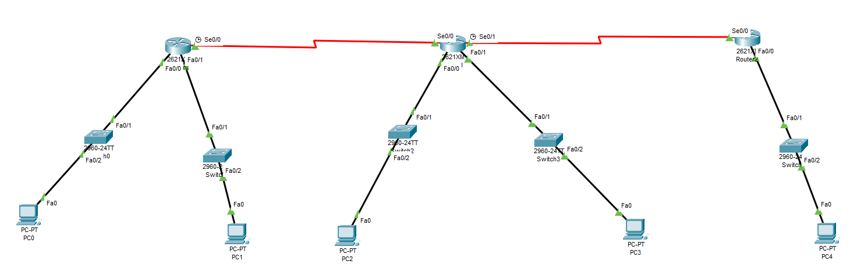







Subnetting
Q2: Company bought an IP 12.1.1.1/8 company says connect 5 branches and connect 1024 users each branch. Using FLSM and using RIPv2.
Network 6
Network 7
Network 5
Network 1
Network 2
Network 3
Network 4

Slide 109
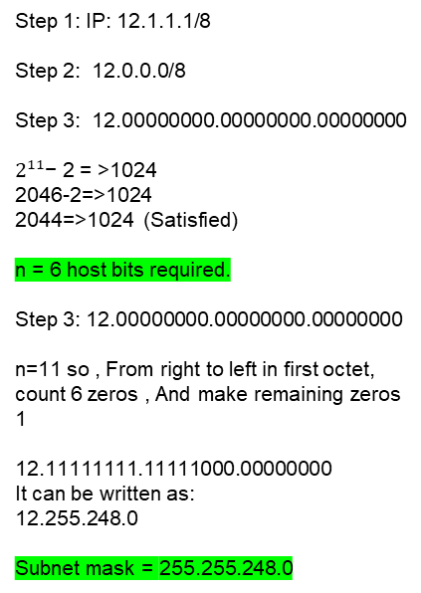
Subnetting
Here we have 7 Network, so let's begin
First Subnetwork:
Network ID: 12.0.0.0/21
Broadcast: 12.0.7.255
Mask: 255.255.248.0
Usable hosts: 12.0.0.1 – 12.0.7.254
2nd Subnetwork:
Network ID: 12.0.8.0/21
Broadcast: 12.0.15.255
Mask: 255.255.248.0
Usable hosts: 12.0.8.1 – 12.0.15.254
3rd Subnetwork:
Network ID: 12.0.16.0/21
Broadcast: 12.0.23.255
Mask: 255.255.248.0
Usable hosts: 12.0.16.1 – 12.0.23.254
4th Subnetwork:
Network ID: 12.0.24.0/21
Broadcast: 12.0.31.255
Mask: 255.255.248.0
Usable hosts: 12.0.24.1 – 12.0.31.254
5th Subnetwork:
Network ID: 12.0.32.0/21
Broadcast: 12.0.39.255
Mask: 255.255.248.0
Usable hosts: 12.0.32.1 – 12.0.39.254
6th Subnetwork:
Network ID: 12.0.40.0/21
Broadcast: 12.0.47.255
Mask: 255.255.248.0
Usable hosts: 12.0.40.1 – 12.0.47.254
7th Subnetwork:
Network ID: 12.0.48.0/21
Broadcast: 12.0.55.255
Mask: 255.255.248.0
Usable hosts: 12.0.48.1 – 12.0.55.254
Step 1: IP: 12.1.1.1/8
Step 2: 12.0.0.0/8
Step 3: 12.00000000.00000000.00000000
$2^{11}$− 2 = >1024
2046-2=>1024
2044=>1024 (Satisfied)
n = 6 host bits required.
Step 3: 12.00000000.00000000.00000000
n=11 so , From right to left in first octet, count 6 zeros , And make remaining zeros 1
12.11111111.11111000.00000000
It can be written as:
12.255.248.0
Subnet mask = 255.255.248.0

Slide 110







Subnetting
Q2: Practical,Using RIPv2
12.0.48.2
R3
R1
Network 6
12.0.40.2
R2
Network 7
12.0.40.1
12.0.48.1
12.0.0.1
12.0.8.1
12.0.24.1
12.0.32.1
12.0.16.1
Network 5
Network 1
Network 2
Network 3
Network 4

Slide 111
Subnetting
Q2: Practical,Using RIPv2
R2
Router> enable
Router# configure terminal
Router(config)# interface FastEthernet0/0
Router(config-if)# ip address 12.0.16.1 255.255.248.0
Router(config-if)# no shutdown
Router(config-if)# exit
Router(config)# interface FastEthernet0/1
Router(config-if)# ip address 12.0.24.1 255.255.248.0
Router(config-if)# no shutdown
Router(config-if)# exit
Router(config)# interface Serial0/0
Router(config-if)# ip address 12.0.40.2 255.255.248.0
Router(config-if)# no shutdown
Router(config-if)# exit
Router(config)# interface Serial0/1
Router(config-if)# ip address 12.0.48.1 255.255.248.0
Router(config-if)# no shutdown
Router(config-if)# exit
Router(config)# router rip
Router(config-router)# version 2
Router(config-router)# network 12.0.0.0
Router(config-router)# no auto-summary
Router(config-router)# exit
Router(config)# exit
Router#
R1
Router> enable
Router# configure terminal
Router(config)# interface FastEthernet0/0
Router(config-if)# ip address 12.0.0.1 255.255.248.0
Router(config-if)# no shutdown
Router(config-if)# exit
Router(config)# interface FastEthernet0/1
Router(config-if)# ip address 12.0.8.1 255.255.248.0
Router(config-if)# no shutdown
Router(config-if)# exit
Router(config)# interface Serial0/0
Router(config-if)# ip address 12.0.40.1 255.255.248.0 Router(config-if)# no shutdown
Router(config-if)# exit
Router(config)# router rip
Router(config-router)# version 2
Router(config-router)# network 12.0.0.0
Router(config-router)# no auto-summary
Router(config-router)# exit
Router(config)# exit
Router#

Slide 112
Subnetting
Q2: Practical, Using RIPv2
R3
Router> enable
Router# configure terminal
Router(config)# interface FastEthernet0/0
Router(config-if)# ip address 12.0.32.1 255.255.248.0
Router(config-if)# no shutdown
Router(config-if)# exit
Router(config)# interface Serial0/0
Router(config-if)# ip address 12.0.48.2 255.255.248.0
Router(config-if)# no shutdown
Router(config-if)# exit
Router(config)# router rip
Router(config-router)# version 2
Router(config-router)# network 12.0.0.0
Router(config-router)# no auto-summary
Router(config-router)# exit
Router(config)# exit
Router#
no auto-summary in RIP is used to stop RIP from shortening routes and instead send the full subnet information

Slide 113
Subnetting
Other Practical:
Assignment:
Class A :
10.10.10.100/8, Connect 3 branches, 45 users each
10.10.10.10/8, Connect 3 branches, 60 users each
20.10.10.30/8, Connect 4 branches, 50 users each
30.20.20.20/8, Connect 7 branches, 20 users each
40.40.40.30/8, Connect 2 branches, 118 users each

Slide 114
Subnetting
VLSM Using Class C:

Slide 115
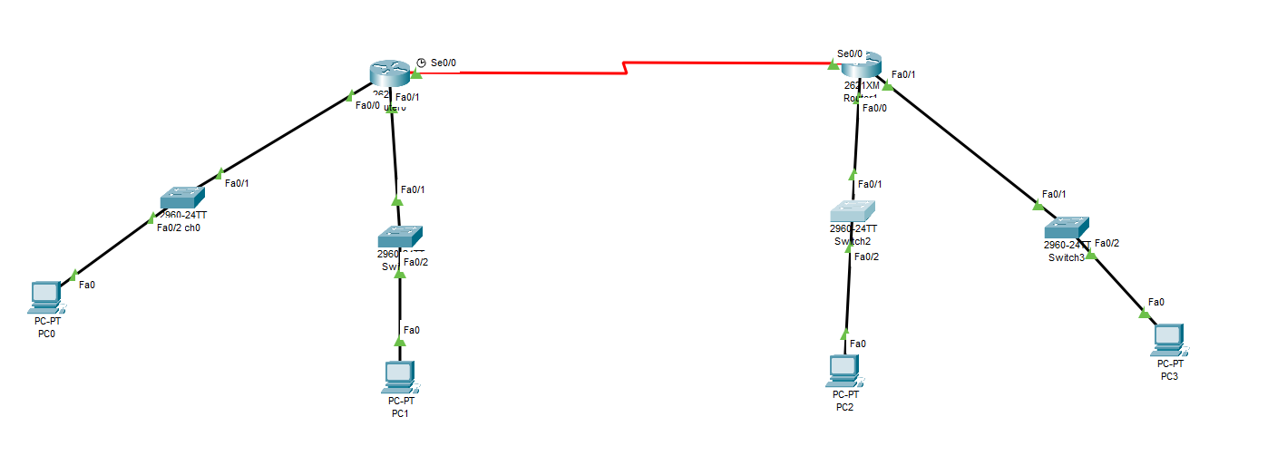





Subnetting
Q1: Company bought an IP 197.10.10.0 ; company says connect 4 branches, Each branch users 30,20,10,4.
Network 5
Network 4
Network 1
Network 2
Network 3
30 users
4 users
20 users
10 Users

Slide 116
Subnetting
Here we have 5 Network, so let's begin , First start from the maximum users and go on
First Subnetwork:
197.10.10.00000000
2^5 − 2 = >30
32 -2=>30
30=>30 (Satisfied)
n = 5 host bits required.
Step 3: 197.10.10.00000000
n=5 so , From right to left in first octet, count 5 zeros , And make remaining zeros 1
197.10.10.11100000
197.10.10.224
Subnet mask = 255.255.255.224
IPs
Network ID: 197.10.10.0/27
Mask: 255.255.255.224
Broadcast: 197.10.10.31/27
Usable hosts: 197.10.10.1 → 197.10.10.30
Next network will start from 197.10.10.32
2nd Subnetwork:
197.10.10.00000000
2^n -2 =>20
2^5 -2 => 20
32-2 => 20
30 =>20 ,
n = 5 host bits required.
197.10.10.00000000
n=5 so , From right to left in first octet, count 5 zeros , And make remaining zeros 1
197.10.10.11100000
197.10.10.224
Subnet mask = 255.255.255.224
IPs
Network ID : 197.10.10.32/27
Mask: 255.255.255.224
Broadcast : 197.10.10.63/27
Usable IPs : 197.10.10.33 to 197.10.10.62
Next network will start from 197.10.10.64

Slide 117
Subnetting
Here we have 5 Network, so let's begin , First start from the maximum users and go on
3rd Subnetwork:
197.10.10.00000000
2^4 − 2 = >10
16 -2=>10
14=>10 (Satisfied)
n = 4 host bits required.
Step 3: 197.10.10.00000000
n=4 so , From right to left in first octet, count 4 zeros , And make remaining zeros 1
197.10.10.11110000
197.10.10.240
Subnet mask = 255.255.255.240
IPS
Network ID: 197.10.10.64/28
Mask: 255.255.255.224
Broadcast: 197.10.10.79/28
Usable hosts: 197.10.10.65 → 197.10.10.78
Next network will start from 197.10.10.80
4th Subnetwork:
197.10.10.00000000
2^n -2 =>4
2^3 -2 => 4
8-2 => 4
6 =>4 ,
n = 3 host bits required.
197.10.10.00000000
n=3 so , From right to left in first octet, count 3 zeros , And make remaining zeros 1
197.10.10.11111000
197.10.10.248
Subnet mask = 255.255.255.248
IPS
Network ID : 197.10.10.80/29
Mask: 255.255.255.248
Broadcast : 197.10.10.87/29
Usable IPs : 197.10.10.81 to 197.10.10.86
Next network will start from 197.10.10.88

Slide 118
Subnetting
Here we have 5 Network, so let's begin , First start from the maximum users and go on
5th Subnetwork:
197.10.10.00000000
2^2 − 2 = >2
4 -2=>2
2=>2 (Satisfied)
n = 2 host bits required.
Step 3: 197.10.10.00000000
n=2 so , From right to left in first octet, count 2 zeros , And make remaining zeros 1
197.10.10.11111100
197.10.10.252
Subnet mask = 255.255.255.252
IPS
Network ID: 197.10.10.88/30
Mask: 255.255.255.252
Broadcast: 197.10.10.91/30
Usable hosts: 197.10.10.89 → 197.10.10.90
Next network will start from 197.10.10.92

Slide 119





Subnetting
Q2: Company bought an IP 12.0.0.0/8 ; company says connect 4 branches, Each branch users 1000,600,100,50.
Network 5
Network 4
Network 1
Network 2
Network 3
1000 users
50 users
600 users
100 Users

Slide 120
Subnetting
Here we have 5 Network, so let's begin , First start from the maximum users and go on
First Subnetwork for 1000 users:
12.0000000.0000000.000000
2^n -2 >= 1000
2^10 -2 >=1000
1024 -2 >= 1000
1022 >= 1000 , n=10
n = 10 host bits required.
12.0000000.0000000.000000
12.11111111.11111100.00000000
n=10 so , From right to left in first octet, count 10 zeros , And make remaining zeros 1
12.255.252.0
Subnet mask = 255.255.252.0
IPs
Network ID: 12.0.0.0/22
Mask: 255.255.252.0
Broadcast: 12.0.3.255/22
Usable IPs : 12.0.0.1 to 12.0.3.254
Next Network : 12.0.4.0
2nd Subnetwork for 600 users:
12.0000000.0000000.000000
2^n -2 >= 1000
2^10 -2 >=1000
1024 -2 >= 1000
1022 >= 1000 , n=10
n = 10 host bits required.
12.0000000.0000000.000000
12.11111111.11111100.00000000
n=10 so , From right to left in first octet, count 10 zeros , And make remaining zeros 1
12.255.252.0
Subnet mask = 255.255.252.0
IPs
Network ID: 12.0.4.0/22
Mask: 255.255.252.0
Broadcast: 12.0.7.255
Usable IPs : 12.0.4.1 to 12.0.7.254
Next network : 12.0.8.0

Slide 121
Subnetting
Here we have 5 Network, so let's begin , First start from the maximum users and go on
3rd Subnetwork for 100 users:
12.0000000.0000000.000000
2^n -2 >= 100
2^7 -2 >=100
128 -2 >= 100
126 >= 100 , n=7
n = 7 host bits required.
12.0000000.0000000.000000
12.11111111.11111111.10000000
n=7 so , From right to left in first octet, count 7 zeros , And make remaining zeros 1
12.255.255.128
Subnet mask = 255.255.255.128
IPs
Network ID: 12.0.8.0/25
Mask: 255.255.255.128
Broadcast: 12.0.8.127/25
Usable IPs : 12.0.8.1 to 12.0.8.126
Next Network : 12.0.8.128
4th Subnetwork for 100 users:
12.0000000.0000000.000000
2^n -2 >= 50
2^6 -2 >=50
64 -2 >= 50
62 >= 50 , n=6
n = 6 host bits required.
12.0000000.0000000.000000
12.11111111.11111111.11000000
n=6 so , From right to left in first octet, count 6 zeros , And make remaining zeros 1
12.255.255.192
Subnet mask = 255.255.255.192
IPs
Network ID: 12.0.8.128/26
Mask: 255.255.255.192
Broadcast: 12.0.8.191/26
Usable IPs : 12.0.8.129 to 12.0.8.190
Next Network : 12.0.8.192

Slide 122
Subnetting
Here we have 5 Network, so let's begin , First start from the maximum users and go on
5th Subnetwork for 2 users:
12.0000000.0000000.000000
2^n -2 >= 2
2^2 -2 >=2
4 -2 >= 2
2 >= 2 , n=2
n = 2 host bits required.
12.0000000.0000000.000000
12.11111111.11111111.11111100
n=2 so , From right to left in first octet, count 2 zeros , And make remaining zeros 1
12.255.255.252
Subnet mask = 255.255.255.252
IPs
Network ID: 12.0.8.192/30
Mask: 255.255.255.252
Broadcast: 12.0.8.195/30
Usable IPs : 12.0.8.193 to 12.0.8.194
Next Network : 12.0.8.196

Slide 123
Subnetting
Assignment (VLSM):
Class A:
A company says, We have purchased the IP address 192.168.10.0/24. You need to connect.
1st Branch, Users 60
2nd Branch, Users 30
3rd Branch, Users 14
4th Branch, Users 6
Class B:
A company says, We have purchased the IP address 172.16.50.0/23. You need to connect.
1st Branch, Users 120
2nd Branch, Users 50
3rd Branch, Users 10
4th Branch, Users 2

Slide 124
Subnetting
Assignment (VLSM):
Class C:
A company says, We have purchased the IP address 10.20.30.0/22. You need to connect.
1st Branch, Users 250
2nd Branch, Users 100
3rd Branch, Users 28
4th Branch, Users 5

Slide 125
Subnetting
Difference between classful and classless protocol:
✅ Classful Protocol
Does not send subnet mask in routing updates.
Assumes default IP classes (A, B, C).
Does not support VLSM (Variable Length Subnet Masking).
💡 Example: Classful: RIPv1
✅ Classless Protocol
Sends subnet mask with routing updates.
Ignores default IP classes.
Supports VLSM and complex subnetting.
💡 Example: Classless: RIPv2, OSPF, EIGRP (modern)

Slide 126
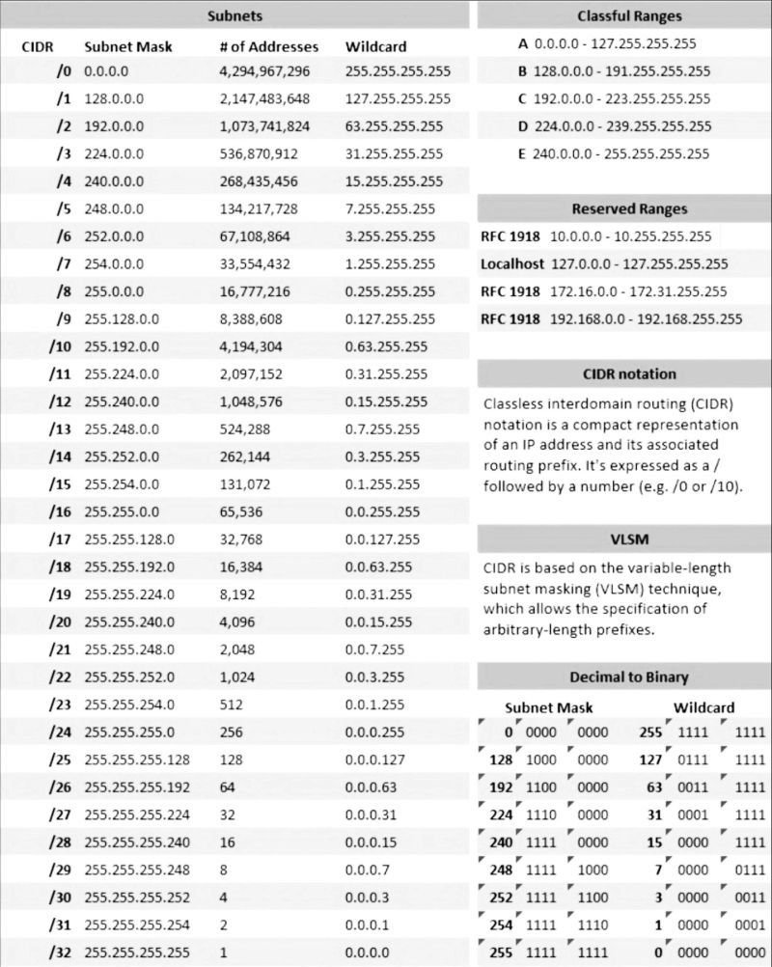

Slide 127
IPv6 Addressing & IPv6 Address types
The Future of Internet Addressing
Why IPv6?
IPv4 limitations (IPv4 exhaustion, growing internet devices)
Need for more addresses
IPv6 Address Structure:
128-bit address (vs. IPv4’s 32-bit)
Hexadecimal notation (e.g., 2001:0db8:85a3::8a2e:0370:7334)
8 groups of 4 hex digits, separated by colons (:)
IPv6 Address Representation:
Shortening rules:
Leading zeros can be omitted (09C0 → 9C0)
Consecutive zeros can be replaced with :: (once per address)
Example 1:
Full: 2001:0db8:0000:0000:0000:ff00:0042:8329
Shortened: 2001:db8::ff00:42:8329
There is no concept of classes in IPv6 like there was in IPv4 (Class A, B, C, etc.).
Example 2:
Full: 2001:0db8:0000:0000:0000:0000:0000:0001
Shortened: 2001:db8::1

Slide 128
IPv6 Addressing & IPv6 Address types
The Future of Internet Addressing
Types of IPv6 Addresses
Unicast Address = One-to-One
Sends data to one single device.
Think of it like sending a letter to a friend's home address.
Types of Unicast:
Global Unicast – Used to communicate across the internet (starts with 2 or 3)
Link-Local – Used only on local network (starts with FE80::)
Unique Local – Used in private networks (starts with FC00:: or FD00::)

Slide 129
IPv6 Addressing & IPv6 Address types
The Future of Internet Addressing
Types of IPv6 Addresses
Multicast Address = One-to-Many
Sends data to a group of devices at once.
Like sending a group message to all students in a class.
Starts with FF (like FF02::1 for all nodes, FF02::2 for all routers)

Slide 130
IPv6 Addressing & IPv6 Address types
The Future of Internet Addressing
Types of IPv6 Addresses
Anycast Address = One-to-One-of-Many
Sent to a group of devices, but only the nearest one gets it.
Like asking for help, and the closest helper replies.
Devices share the same address, but routing picks the nearest one.

Slide 131
IPv6 Addressing & IPv6 Address types
The Future of Internet Addressing
What is Prefix Length (/64, /48, etc.) in IPv6?
Prefix length means how many bits are used for the network part of the address.
/64 means first 64 bits are the network ➔ remaining 64 bits are for the host (devices).
/48 means first 48 bits are the network ➔ remaining 80 bits are for subnetting + hosts.
Example in Easy Words:
Prefix | Meaning | Usage
/64 | First 64 bits for network, rest 64 bits for devices | Most common, for LANs (Switches, Routers, PCs)
/48 | First 48 bits for big network, then you can create many /64 subnets | Used by companies, ISPs
/128 | All 128 bits are used | Assigned to a single device (like a printer or loopback)

Slide 132
IPv6 Addressing & IPv6 Address types
The Future of Internet Addressing
Very Simple Analogy:
✅ Think of IPv6 address as a phone number 📞.
✅ The prefix (/64, /48) is like the area code — it tells where you are.
✅ The remaining bits are like the individual number — who exactly you are.
IPv4 uses Subnet Mask. IPv6 uses Prefix Length.
/64 = Standard network for normal devices.

Slide 133
IPv6 Addressing & IPv6 Address types
The Future of Internet Addressing
IPv6 Lab:
Short Form | Full Form
2001:1::1 | 2001:0001:0000:0000:0000:0000:0000:0001
2001:1::10 | 2001:0001:0000:0000:0000:0000:0000:0010
2001:2::1 | 2001:0002:0000:0000:0000:0000:0000:0001
2001:2::10 | 2001:0002:0000:0000:0000:0000:0000:0010

Slide 134
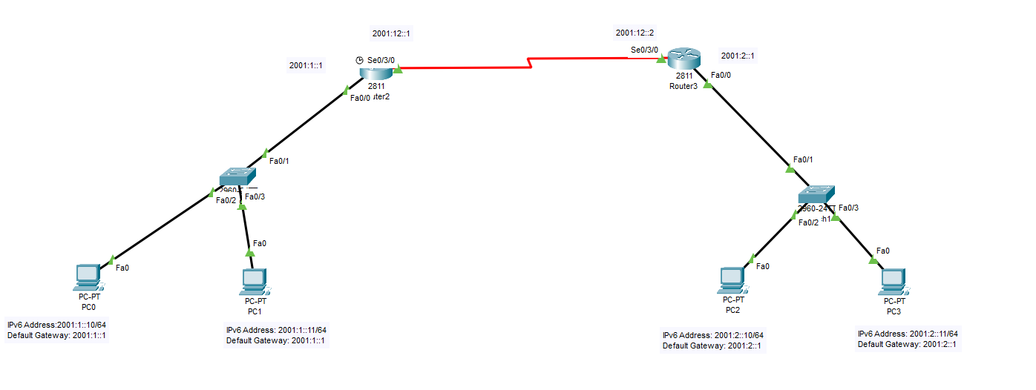
IPv6 Addressing & IPv6 Address types
The Future of Internet Addressing
IPv6 Lab:
R1
R2

Slide 135
IPv6 Addressing & IPv6 Address types
The Future of Internet Addressing
IPv6 Lab:
By default, IPv6 is disabled on router, You need to enable it using the command :R1(config)# ipv6 unicast-routing
RIPng for Routing Protocol:
      We're using IPv6, we’ll configure RIPng (RIP Next Generation), because normal RIP works only for IPv4.
MYRIP is just a name. You can call it anything like RIPLAB or TESTRIP.
RIPng is enabled under the interface

Slide 136
IPv6 Addressing & IPv6 Address types
The Future of Internet Addressing
IPv6 Lab:
R1> enable
R1# configure terminal
R1(config)# ipv6 unicast-routing
R1(config)# interface fa0/0
R1(config-if)# ipv6 address 2001:1::1/64
R1(config-if)# ipv6 rip MYRIP enable
R1(config-if)# no shutdown
R1(config-if)# exit
R1(config)# interface s0/0
R1(config-if)# ipv6 address 2001:12::1/64
R1(config-if)# ipv6 rip MYRIP enable
R1(config-if)# no shutdown
R1(config-if)# exit
R1(config)# ipv6 router rip MYRIP
R1(config-rtr)# exit
R1(config)# exit
R2> enable
R2# configure terminal
R2(config)# ipv6 unicast-routing
R2(config)# interface fa0/0
R2(config-if)# ipv6 address 2001:2::1/64
R2(config-if)# ipv6 rip MYRIP enable
R2(config-if)# no shutdown
R2(config-if)# exit
R2(config)# interface s0/0
R2(config-if)# ipv6 address 2001:12::2/64
R2(config-if)# ipv6 rip MYRIP enable
R2(config-if)# no shutdown
R2(config-if)# exit
R2(config)# ipv6 router rip MYRIP
R2(config-rtr)# exit
R2(config)# exit
Router#show ipv6 route → Result

Slide 137
What is a Network Model?
A network model is a set of rules that help computers communicate with each other.
It shows how data moves from one computer to another over the internet.
Two Main Network Models
OSI Model (Open Systems Interconnection)
TCP/IP Model (Transmission Control Protocol / Internet Protocol)

Slide 138
OSI Reference Model
Understanding the Structure of Network Communications

Slide 139
Introduction to OSI Model
What is OSI Model?
Stands for : Open Systems Interconnection model
A conceptual framework used to understand how data is transmitted between devices over a network.
It is a theoretical model to explain how data moves from one device to another.
Purpose: To standardize communication between different systems
Layer 7: Application Layer
Layer 6: Presentation Layer
Layer 5: Session Layer
Layer 4: Transport Layer
Layer 3: Network Layer
Layer 2: Data Link Layer
Layer 1: Physical Layer

Slide 140
The Seven Layers
Layer 7: Application Layer Provides network services to end users.
Example: HTTP, FTP
Layer 6: Presentation Layer Formats data for the application layer.
Example: Data encryption, compression
Layer 5: Session Layer Manages sessions, establishes, maintains, and terminates connections.
Example: Network dialogues like login sessions.
Layer 4: Transport Layer Ensures reliable data transfer between devices.
Example: TCP, UDP
Layer 3: Network Layer Handles logical addressing (IP addresses) and routing.
Example: IP routing, routers
Layer 2: Data Link Layer Manages physical addresses (MAC addresses) and error detection.
Example: Ethernet, switches
Layer 1: Physical Layer Transmits raw binary data over physical media.
Example: Cables, NIC (Network Interface Cards)

Slide 141
The Seven Layers
Layer 7 Application Layer: Provides network services to end users.
This is where users interact with software applications.
It provides the interface between your apps (like WhatsApp, Chrome, Gmail) and the network.
🧒 Simple Example:
When you open Google Chrome and type “www.google.com” – that’s Layer 7.
When you send a WhatsApp message – Layer 7 is involved.
When you check your email using Gmail or Outlook – also Layer 7.
Layer 7 is where humans talk to the network.
✅ Protocols:
HTTP / HTTPS --------------------------- For web browsing (Chrome, Firefox)
SMTP---------------------------------------- For sending emails
POP3 / IMAP-------------------------------For receiving emails
FTP / SFTP --------------------------------For file transfer
DNS------------------------------------------Converts domain names to IP addresses
TELNET / SSH----------------------------For remote login to systems
SNMP----------------------------------------For network device monitoring (e.g. routers)

Slide 142
The Seven Layers
Layer 6 Presentation Layer: Responsible for data translation, encryption, compression.
This layer’s job is to prepare data so the application can understand it.
It translates, encrypts, or compresses the data.
To make data readable for humans and computers, and to secure it before it travels through the network.
🧒 Simple Example:
You receive a message in another language – someone needs to translate it for you. That’s what the presentation layer does.
If someone zips a file (compress it), this layer unzips it for viewing.
If a website uses HTTPS, this layer handles the encryption and decryption of the data.
✅ Protocols:
SSL / TLS –--------------------------Encrypts data (used in HTTPS)
MIME ----------------------------------For email attachments
JPEG, MPEG -----------------------Image and video compression formats (used in apps)

Slide 143
The Seven Layers
Layer 5 Session Layer: Manages sessions or connections between devices..
This layer starts, manages, and ends the communication (session) between two devices.
It makes sure both devices are ready to talk and know when the conversation starts and finishes.
🧒 Simple Example:
Imagine a phone call: You say "Hello" to start, then talk, and then say "Goodbye" to end the call.
➤ That whole conversation is a session, managed by Layer 5.
When you log in to a website, and stay logged in while browsing – that is a session.
🔄 Real-Life Examples:
Zoom call / Skype session – starts and ends a communication.
Online banking login – a secure session starts when you log in and ends when you log out.
Multiple tabs open on a browser – each one has a separate session.
✅ Protocols:
NetBIOS-----------------------------------------------------Windows file and printer sharing
RPC (Remote Procedure Call)-------------------------Lets one computer run programs on another
SIP (Session Initiation Protocol)-----------------------Starts voice/video calls over the internet
PPTP (Point-to-Point Tunneling Protocol)-----------Used in VPNs to manage secure session

Slide 144
The Seven Layers
Layer 4 Transport Layer: Breaks data into segments, checks if data arrived safely and in order
This layer is responsible for delivering the data correctly, completely, and in order.
It also decides whether the communication should be reliable or fast.
To break big messages into smaller pieces (called segments), send them, and make sure they arrive safely at the right place.
🧒 Simple Example:
You send a parcel with tracking – it’s reliable, and you know if it gets delivered (like TCP).
You throw a paper plane in a classroom – it’s fast but may get lost (like UDP).
✅ Protocols:
TCP (Transmission Control Protocol) ---------------------Reliable, slow but safe – used for websites, emails, etc.
UDP (User Datagram Protocol)-----------------------------Fast, but not guaranteed – used for videos, online games, VoIP

Slide 145
The Seven Layers
Layer 3 Network Layer: Handles IP addressing and routing of data
This layer is responsible for finding the best path to send data from one device to another, even if they are in different networks or cities.
It deals with IP addresses and routing.
To figure out where to send the data, using IP addresses and routers to guide the data to its destination.
Layer 3 is the navigator – it finds the best path using IP addresses and routers.
🧒 Simple Example:
Imagine sending a letter: You write the home address on the envelope (IP address), and the post office (router) decides the best route to deliver it.
✅ Protocols:
IP (Internet Protocol)---------------------Main protocol – assigns and uses IP addresses
ICMP-----------------------------------------Used for error reporting and diagnostics (e.g., ping command)
IGMP-----------------------------------------Used for managing multicast groups (one-to-many communication)
IPSec-----------------------------------------Secures IP traffic (used in VPNs)

Slide 146
The Seven Layers
Layer 2 Data Link Layer : Packs bits into frames, handles MAC addresses, and checks for errors
This layer is responsible for sending data within the same network using MAC addresses.
It also detects errors in data and makes sure the message goes to the correct device on the local network.
To deliver data from one device to another within the same network (LAN), like from your PC to a printer or to your Wi-Fi router.
🧒 Simple Example:
In a classroom, each student wears a name tag (MAC address). The teacher (switch) gives the right assignment (data) to the right student using that name tag.
✅ Protocols:
Ethernet (IEEE 802.3) -------------------------Used in wired LANss
Wi-Fi (IEEE 802.11) -------------------------Used in wireless LANs
ARP (Address Resolution Protocol)-------Converts IP address to MAC address

Slide 147
The Seven Layers
Layer 1 Physical Layer: Sends raw bits (0s and 1s) as electrical, light, or radio signals.
This is the lowest layer of the OSI model.
It deals with the actual hardware and signals that carry data — like wires, cables, and Wi-Fi signals.
It transmits raw bits (0s and 1s) as electrical, light, or radio signals.
To physically send and receive data over a medium (cable, air, fiber). It doesn't care what the data is — it just moves bits.
Layer 1 is the messenger's feet – it just moves the message from one place to another.
Common Devices and Technologies at Layer 1:
Ethernet cables (RJ45)-----------------------Wired network cables
Fiber optic cables ------------------------Uses light to transmit data
Wi-Fi signals (Radio) ------------------------Wireless signal transmission
Hubs-----------------------------------------------Device providing centralized connectivity
Network Interface Card (NIC)---------------Sends/receives signals to/from medium
Modems-------------------------------------------Modulate/demodulate signals
Connectors (USB, RJ45)---------------------Physical ports for connection

Slide 148
📤 Sender's Side (You sending "Hi" on WhatsApp)
OSI Layer | What happens
7 – Application | You type “Hi” in WhatsApp and press send.
6 – Presentation | The message is encrypted into code for security.
5 – Session | A session is made with your friend
4 – Transport | The message is broken into segments and sent using TCP to make sure it reaches correctly.
3 – Network | Adds your IP address (sender) and your friend’s IP address (receiver).
2 – Data Link | Adds your MAC address and the next device's MAC address (like your router).
1 – Physical | Message becomes electrical/wireless signals and is sent over Wi-Fi or cable.

Slide 149
📥 Receiver's Side (Your Friend Receiving the Message)
OSI Layer | What happens
1 – Physical | Friend’s device receives the electrical or wireless signals.
2 – Data Link | MAC address is checked to confirm the data is for their device.
3 – Network | IP address is checked to confirm it's meant for their phone.
4 – Transport | Segments are reassembled into the full message. If anything is missing, it asks for a resend (TCP).
5 – Session | It confirms the chat session is still active.
6 – Presentation | The encrypted message is decrypted back into readable text.
7 – Application | WhatsApp shows your message “Hi” on their screen. ✅

Slide 150
TCP/IP Model
What is TCP/IP Model
Stands for : (Transmission Control Protocol / Internet Protocol)
The TCP/IP model is the foundation of the Internet.
It explains how data is sent and received across networks.
Developed in the 1970s by the U.S. Department of Defense.
Consists of 4 layers.
Purpose: The purpose of the TCP/IP model is to allow computers to communicate over a network.
Layers of TCP/IP Model
Application Layer = Services for users.
Transport Layer = Reliable delivery.
Internet Layer = Addressing & routing.
Network Access Layer= Physical transmission.

Slide 151
Layers of TCP/IP Model
1. Application Layer:
Provides network services to users and applications.
Examples of protocols:
HTTP (web browsing)
FTP (file transfer)
SMTP (email)
DNS (domain name system)
Think of it as: The interface between the user and the network.
2. Transport Layer:
Ensures reliable delivery of data.
Main protocols:
TCP (Transmission Control Protocol): Reliable, connection-oriented (e.g., web, email).
UDP (User Datagram Protocol): Faster, connectionless (e.g., video streaming, gaming).

Slide 152
Layers of TCP/IP Model
3. Internet Layer:
Moves data packets across networks.
Key protocols:
IP (Internet Protocol).
Functions:
Addressing (IP addresses)
Routing (choosing best path)
4. Network Access Layer:
Handles hardware addressing and physical transmission of data.
Includes:
Ethernet (wired LAN)
Wi-Fi (wireless LAN)
ARP (Address Resolution Protocol)
Think of it as: The actual road or wires your data travels on.

Slide 153
TCP/IP vs OSI Model
OSI Model: 7 layers (more detailed).
TCP/IP Model: 4 layers (simplified, practical).
TCP/IP is widely used in the real world
Real-Life Analogy:
Sending a letter by mail:
Application Layer: Writing the letter (content).
Transport Layer: Putting it in an envelope, ensuring delivery.
Internet Layer: Adding the address and choosing the route.
Network Access Layer: The delivery truck/road that takes it.

Slide 154
TCP/UDP
🔹 TCP (Transmission Control Protocol)
Reliable: Makes sure all data reaches the other side in the correct order.
Connection-based: A connection is first made between sender and receiver.
Slow but safe: Checks for errors, resends lost data, and confirms delivery.
Used when accuracy matters.
✅ Examples of TCP:
Web Browsing (HTTP/HTTPS)
Email (SMTP, IMAP, POP3)
File Transfer (FTP)
Downloading files
🔹 UDP (User Datagram Protocol)
Unreliable: Does not check if the data arrived or if it’s in order.
Connectionless: Sends data without making a connection.
Fast but risky: No error checking or confirmation.
Used when speed matters more than perfection.
✅ Examples of UDP:
Watching live videos (YouTube Live)
Live Video/Audio Streaming
Online games (PUBG, Call of Duty)
VoIP Calls (like WhatsApp, Zoom, Skype)

Slide 155
TCP/UDP
✅TCP and UDP as the delivery systems (or "delivery trucks") that carry data from one place to another over the internet.
✅ If a YouTube video is not live (like a normal recorded video), then it usually uses TCP, not UDP.
✅If you send a WhatsApp message (like text, photo, or document), then it usually uses TCP
✅If you make a WhatsApp call (voice or video), then it usually uses UDP

Slide 156


Objectives
Aim of Networking
Goal of Networking
To unite devices
Bridging world
A web of connection
Resources flow
To link systems
Secure and fast
To enhance collaboration across distant lands
To build efficiency

Slide 157
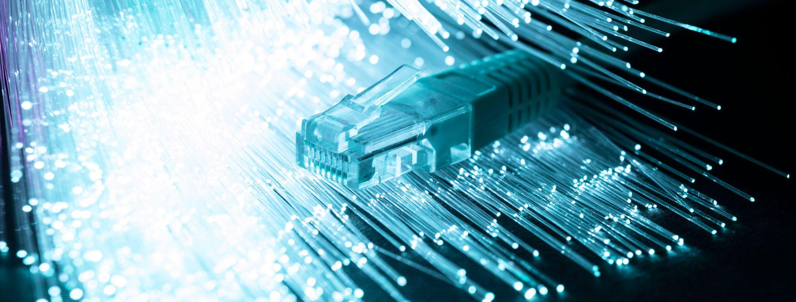
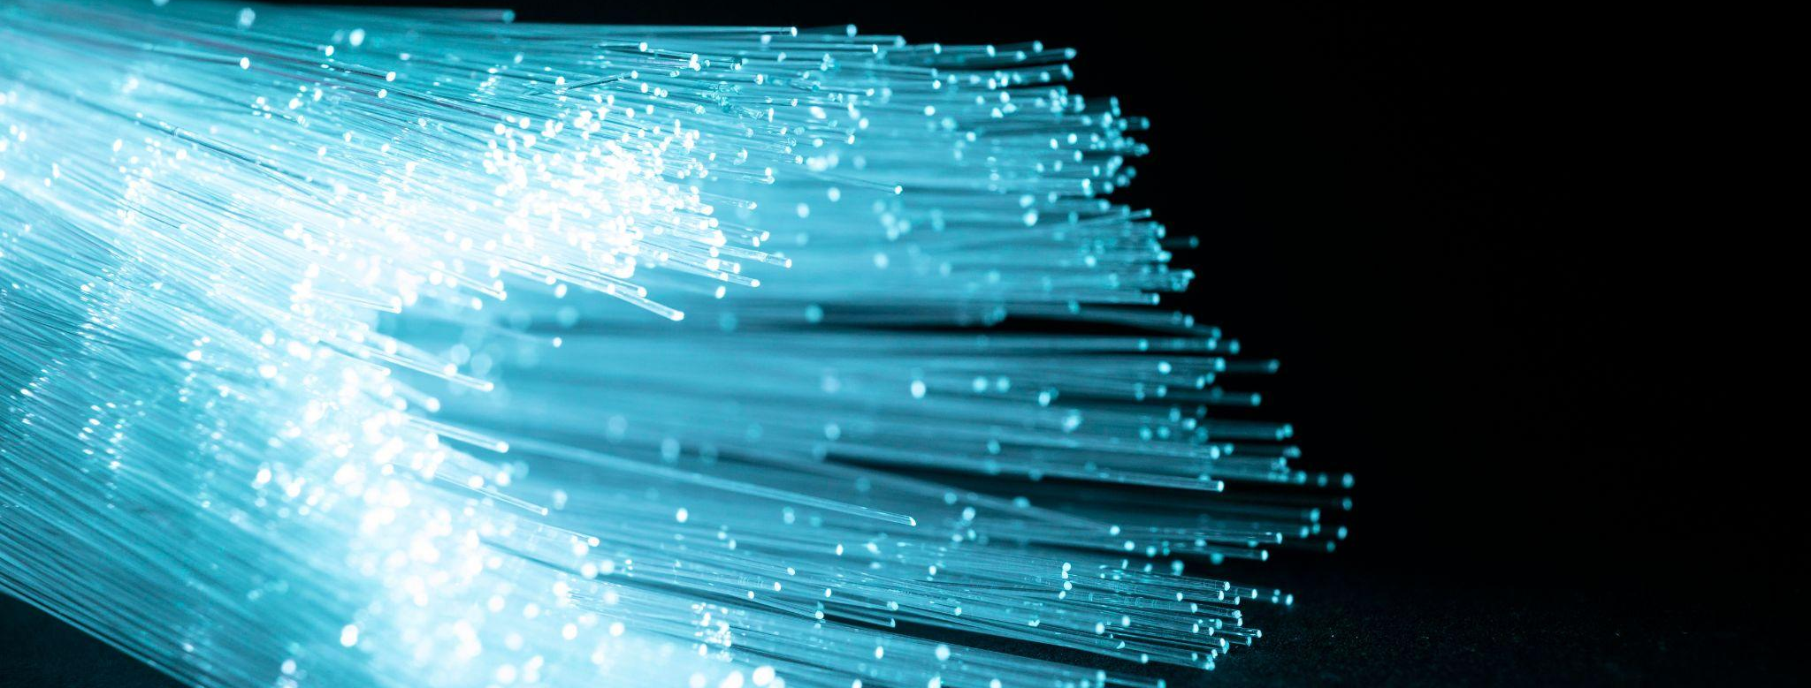
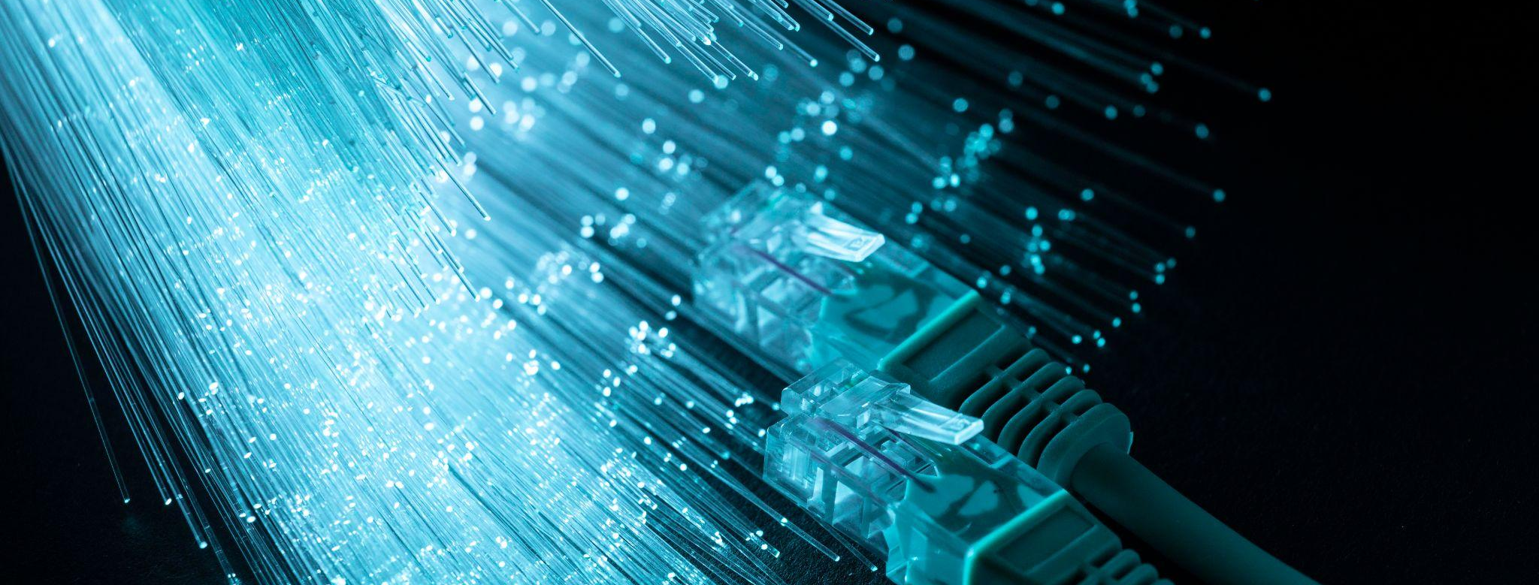
Paths of Possibility
Digital Bridges
Invisible Boundaries
Networks create paths of possibility, transforming ideas into action and connection.
Networks build invisible bridges, linking distant places, and fostering a sense of global unity.
Networks dissolve physical boundaries, creating an invisible network of shared knowledge and ideas.

Slide 158
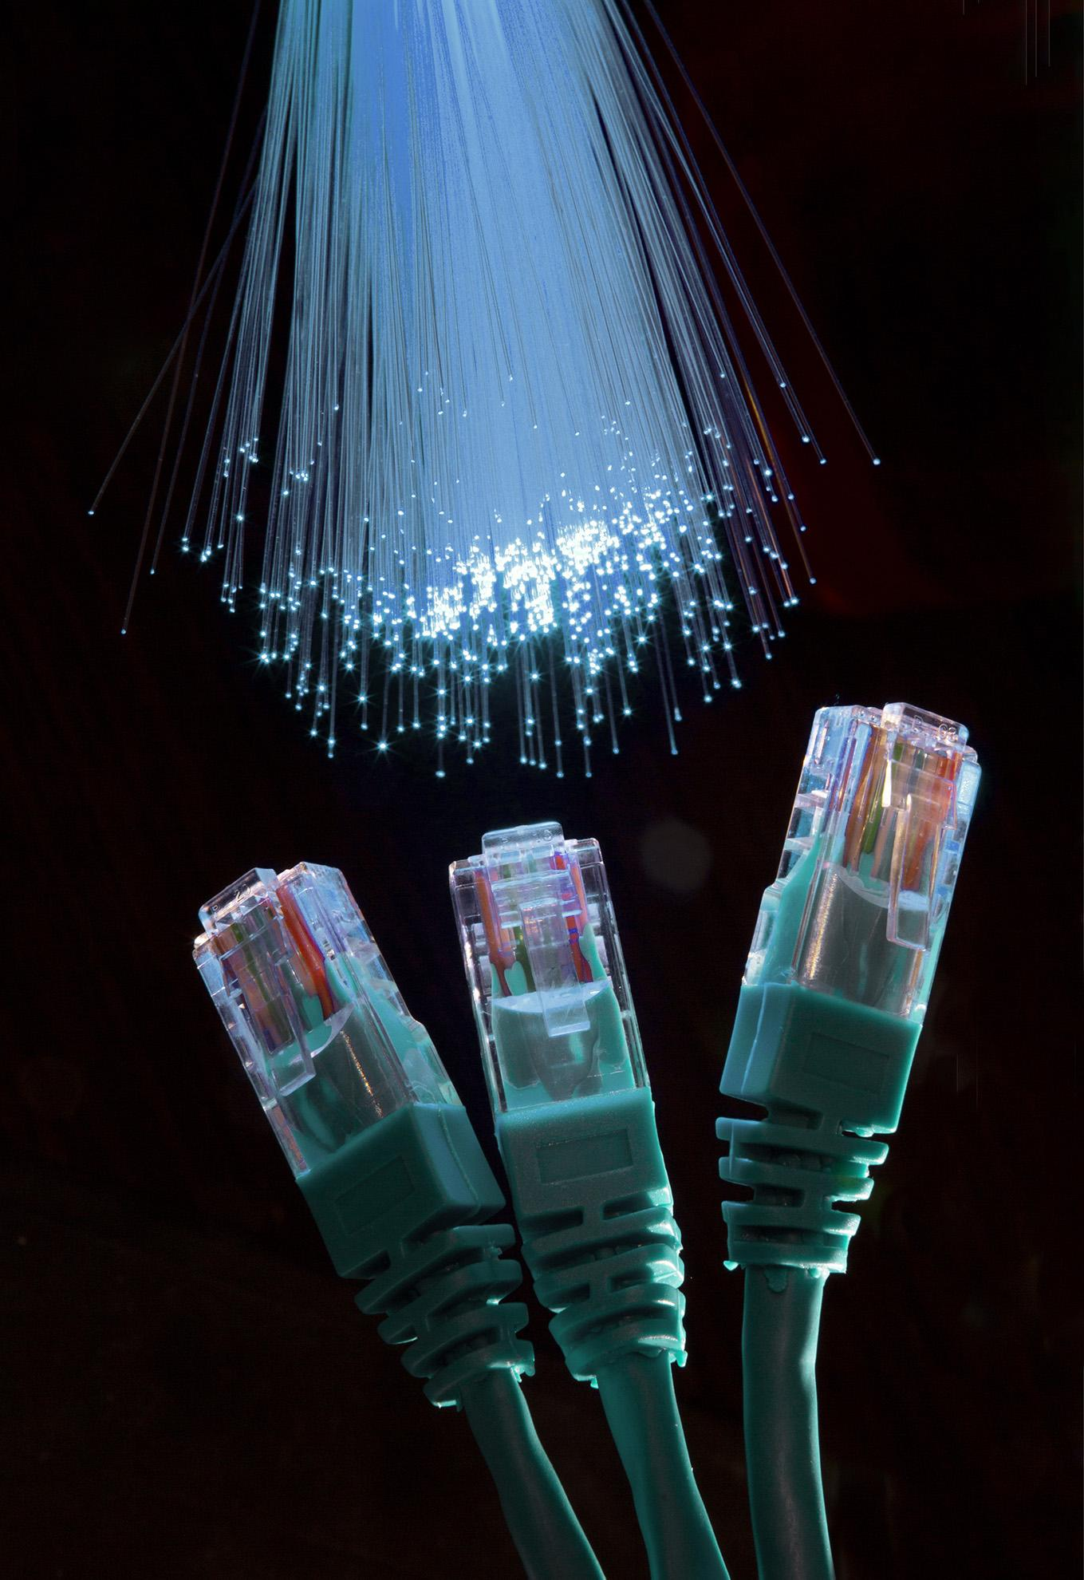
RJ45

Slide 159
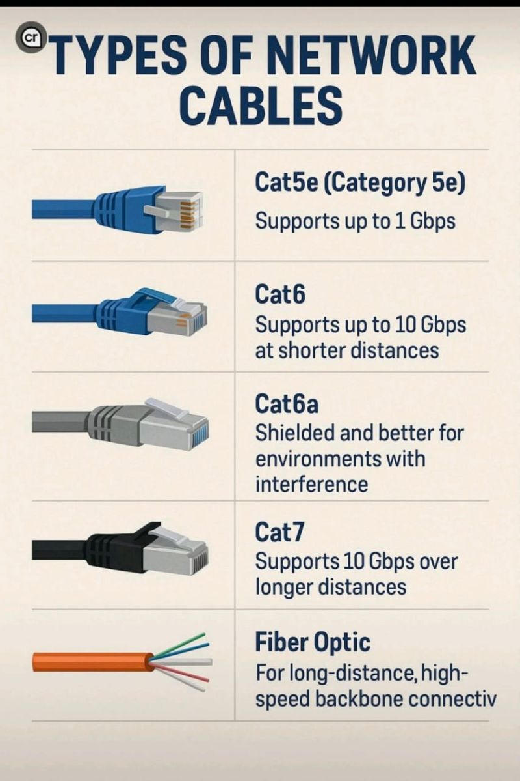

Slide 160
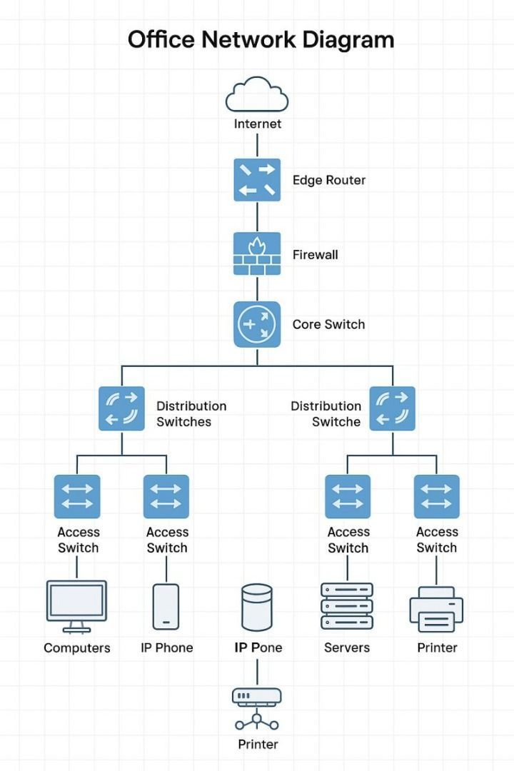
Typical Office Network Diagram

Slide 161
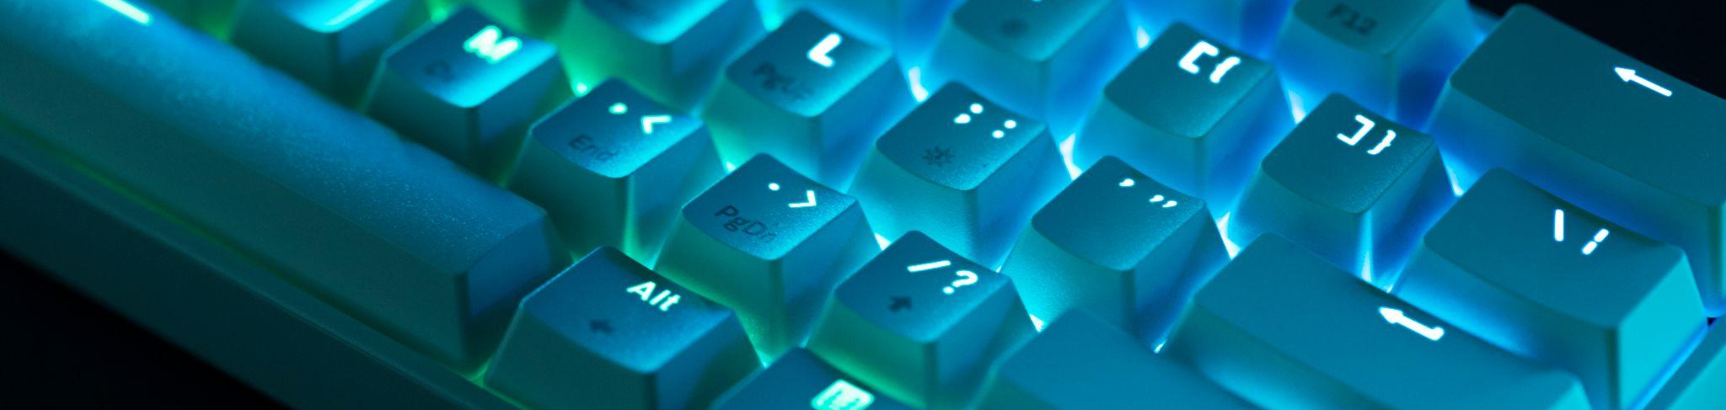
Where Devices and Data Unite

